Slide 1
Using Qualtrics in the Marketing Research Classroom
D’Amore-McKim School of Business
Felicia G. Lassk, Ph.D.
Marketing Group
D’Amore-McKim School of Business
TEXPO
TEACHING IN TECHNOLOGY
April 25, 2017

Slide 2
Agenda
D’Amore-McKim School of Business
Descriptive Research Project Overview
Benefits of Using Qualtrics
Questions

Slide 3
Project Overview
D’Amore-McKim School of Business
Uses: Marketing Research UG and MBA courses
Project: You will be working on a semester-long descriptive research project that will involve identifying a marketing research issue with your selected company. Your group will review the literature and secondary sources of data, determine the sampling plan, design a survey, collect data, and present the results. Your group should collect a sample of 100 respondents from your study’s population of interest.

Slide 4
Policy on Classroom Research Involving Human Subjects
D’Amore-McKim School of Business
A. Student Research that meets the listed requirements are not subject to IRB review.
B. Student research projects must meet all the requirements for Expedited Review.
C. Sensitive information and special populations are excepted.
D. Faculty are responsible for overseeing student projects.

Slide 5
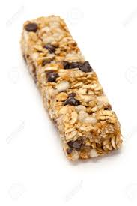
Project Overview
D’Amore-McKim School of Business
Project Clients:
IDEA companies
Co-op/Corporate Residency firms
Service-Learning companies
Northeastern University
Non-Profit organizations
Small businesses

Slide 6
Project Survey
D’Amore-McKim School of Business
Components:
Apply survey design best practices for online/mobile surveys.
Develop survey questions to addresses the project’s research questions/objectives.
Create a survey on Qualtrics.
Share the survey with classmates for feedback.
Gain feedback from the professor.
Pretest the survey.
Have client sign off on the final survey.

Slide 7
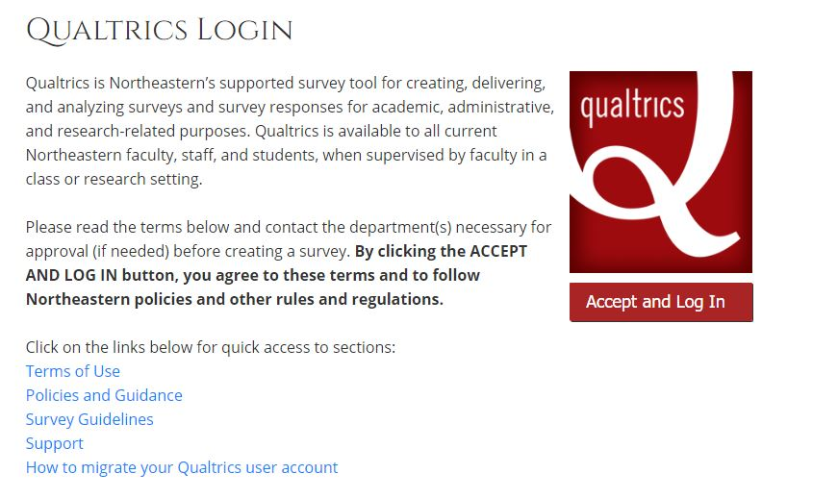
Qualtrics Login: neu.qualtrics.com
D’Amore-McKim School of Business

Slide 8
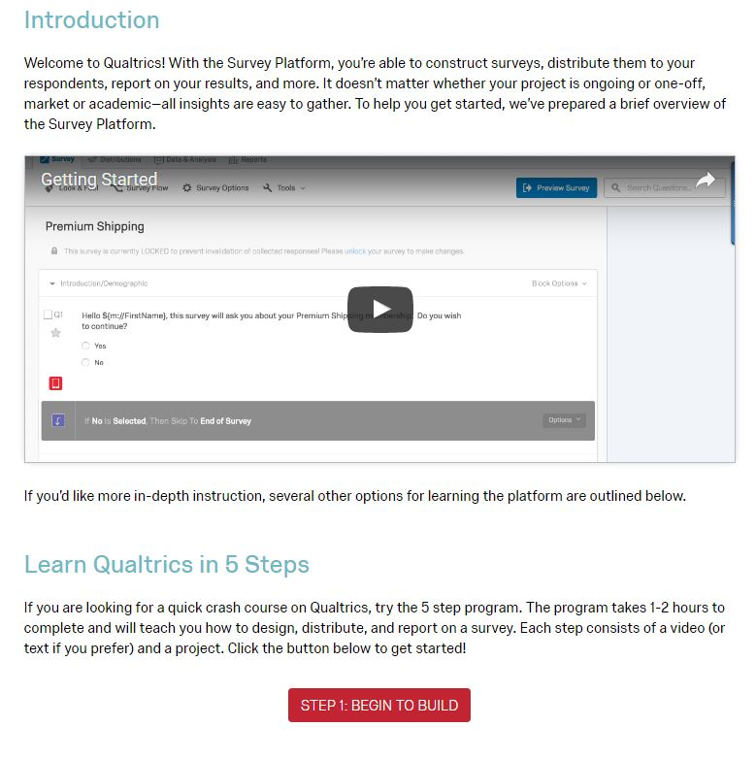
Qualtrics OnlineTraining
D’Amore-McKim School of Business
Qualtrics University provides help and training for all users. Access Qualtrics University by clicking on Help.
Recommend that students view the 5-Step Program to learn how to use the platform.
Qualtrics offers excellent customer service. For specific questions, contact Qualtrics via chat, email or phone.

Slide 9
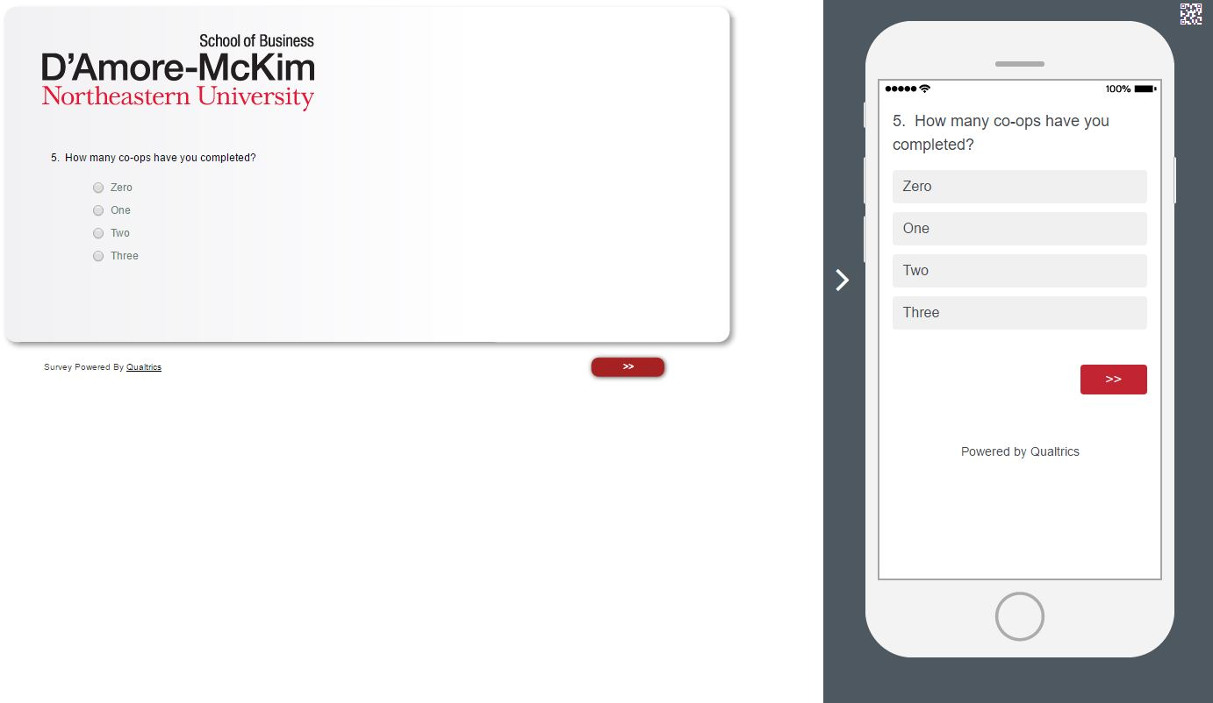
Qualtrics Survey Preview
D’Amore-McKim School of Business
Survey preview shows the survey view on
laptop/desktop computers as well as mobile devices.

Slide 10
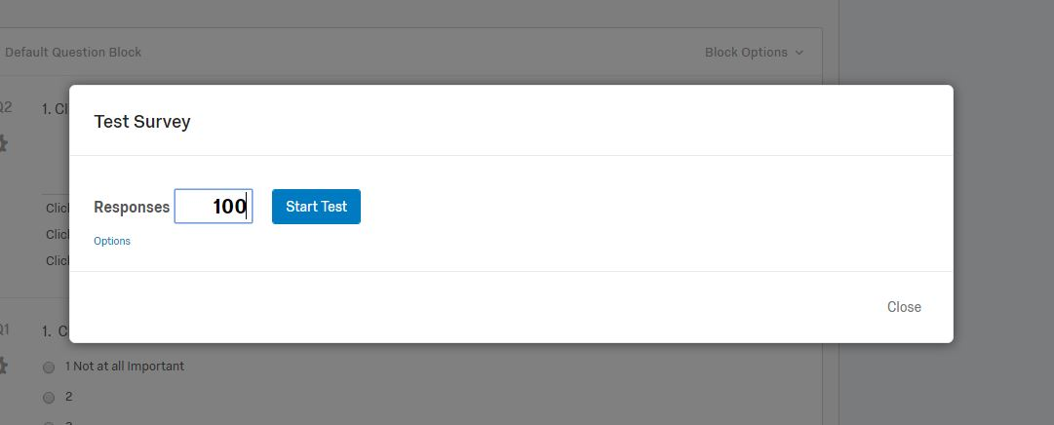
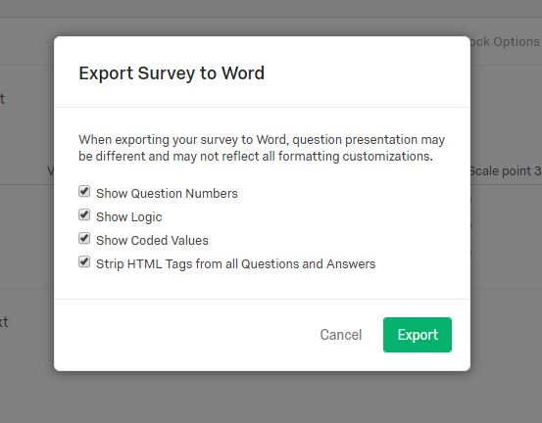
Qualtrics Tools
D’Amore-McKim School of Business

Slide 11
Thank you!
D’Amore-McKim School of Business

