Slide 1
“Digital Posters: Maximizing Instructional Impact.”
Darin Detwiler, LP.D., M.A.Ed.
Assistant Dean, College of Professional Studies, Assistant Teaching Professor

Slide 2
How discussion board POSTERS provide for instructor engagement, assessment of prior learning, building a community of learners, and supporting student success:
Instructor engagement More instructor feedback, more opportunities for instructor to join in discourse, and more access to student work on weekly basis
Assessment of prior learning Actually asking them what they already know and allowing them to ask questions in advance for guest lecturers
Building a community of learners Informal peer review, average of 10 posts per student per week (but not forced), focus on participation, not ‘getting the correct answer’
Supporting student success Increased formative feedback (definitions, APA format, research question, etc.), motivation, shared experience, producing products for success

Slide 3
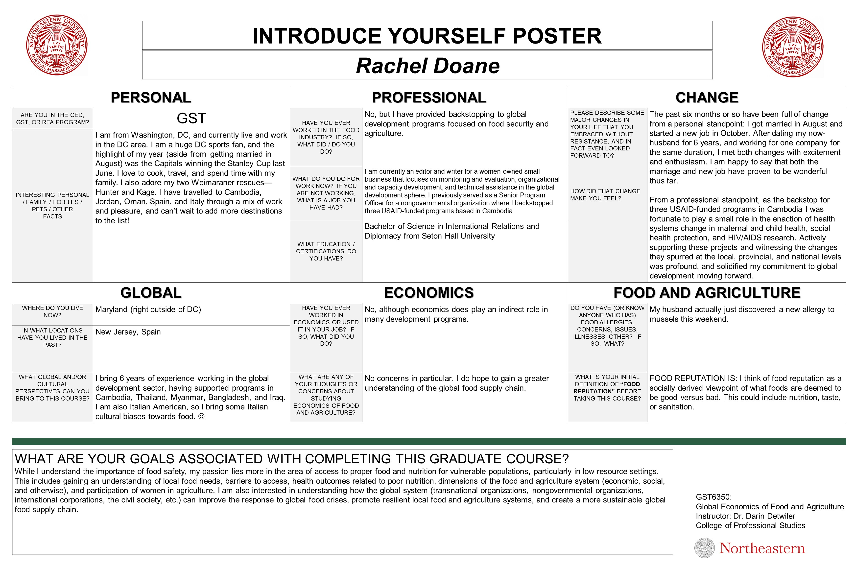
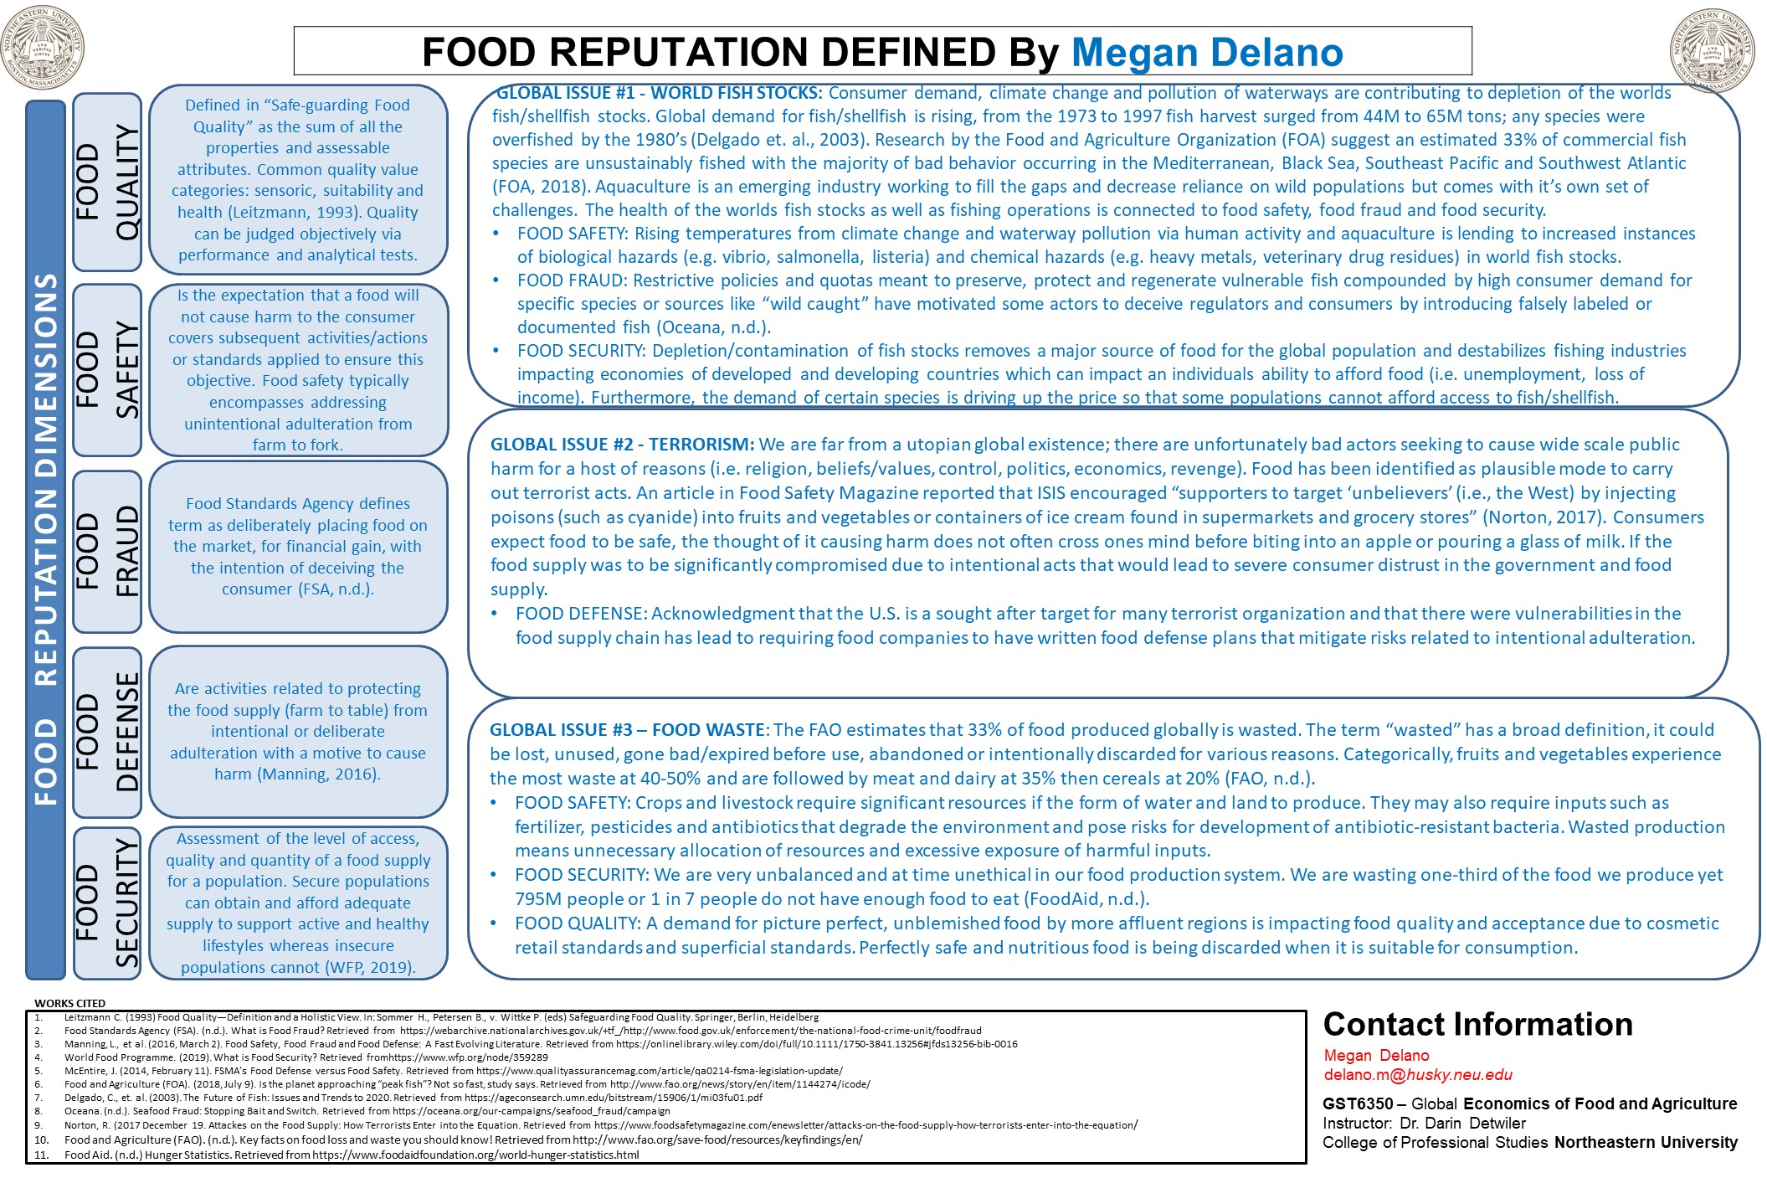
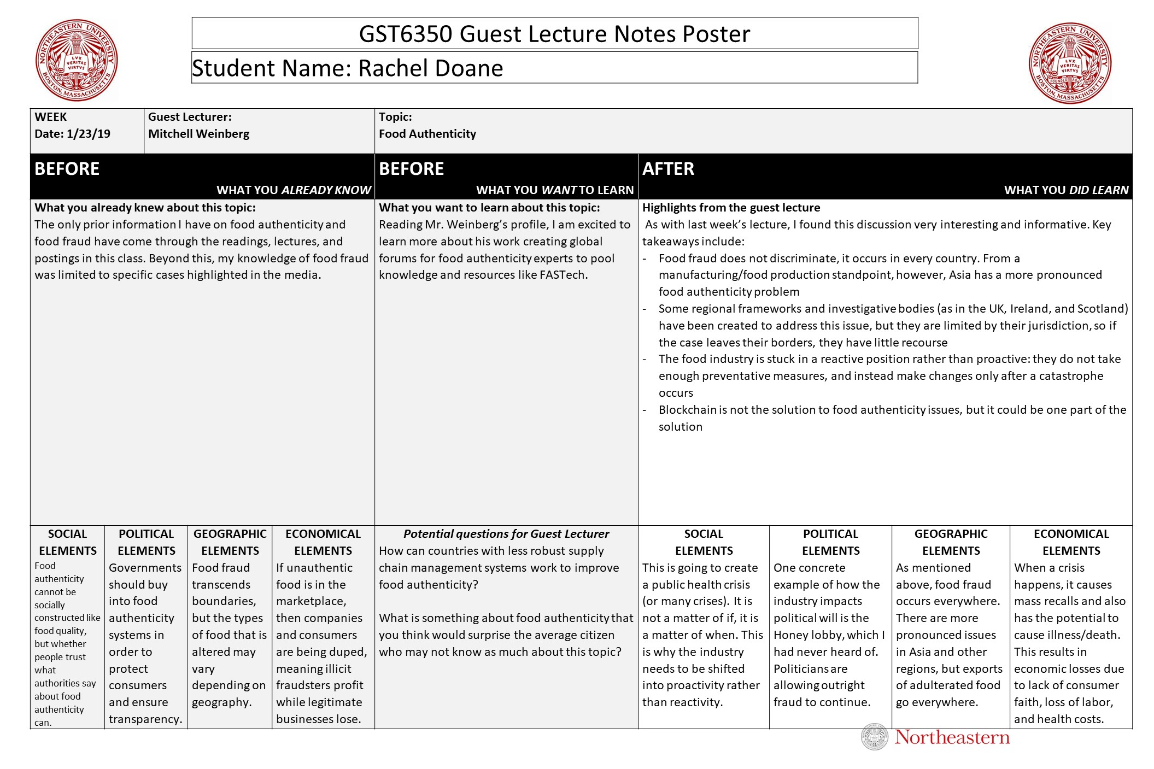
EXAMPLES
instructor engagement, assessment of prior learning, building a community of learners, supporting student success
Week ONE:
Use in “Introduce Yourself” Discussion Board Thread. (Serves as a low threat way to engage students, learn about where they come from professionally and educationally, and to see if they can complete poster steps.)
Week TWO:
Use in own Discussion Board Thread. (Serves as way to make sure students can define key terms and can use APA format for proper citation. Also serves a starter for student discourse during that week as we set the stage for their work in defining their case study research topics.)
ALL WEEKS:
Use in own Discussion Board Thread. (“Before” and “After” posters for use in engaging students prior to class. Gains questions for lecturers. Builds community of learners. Also serves a starter for student discourse during that week.)

Slide 4
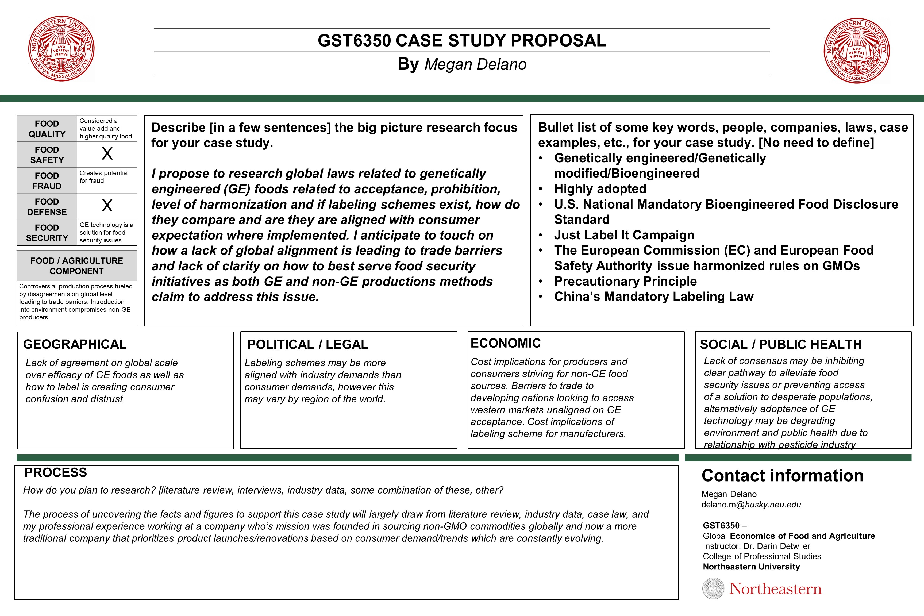
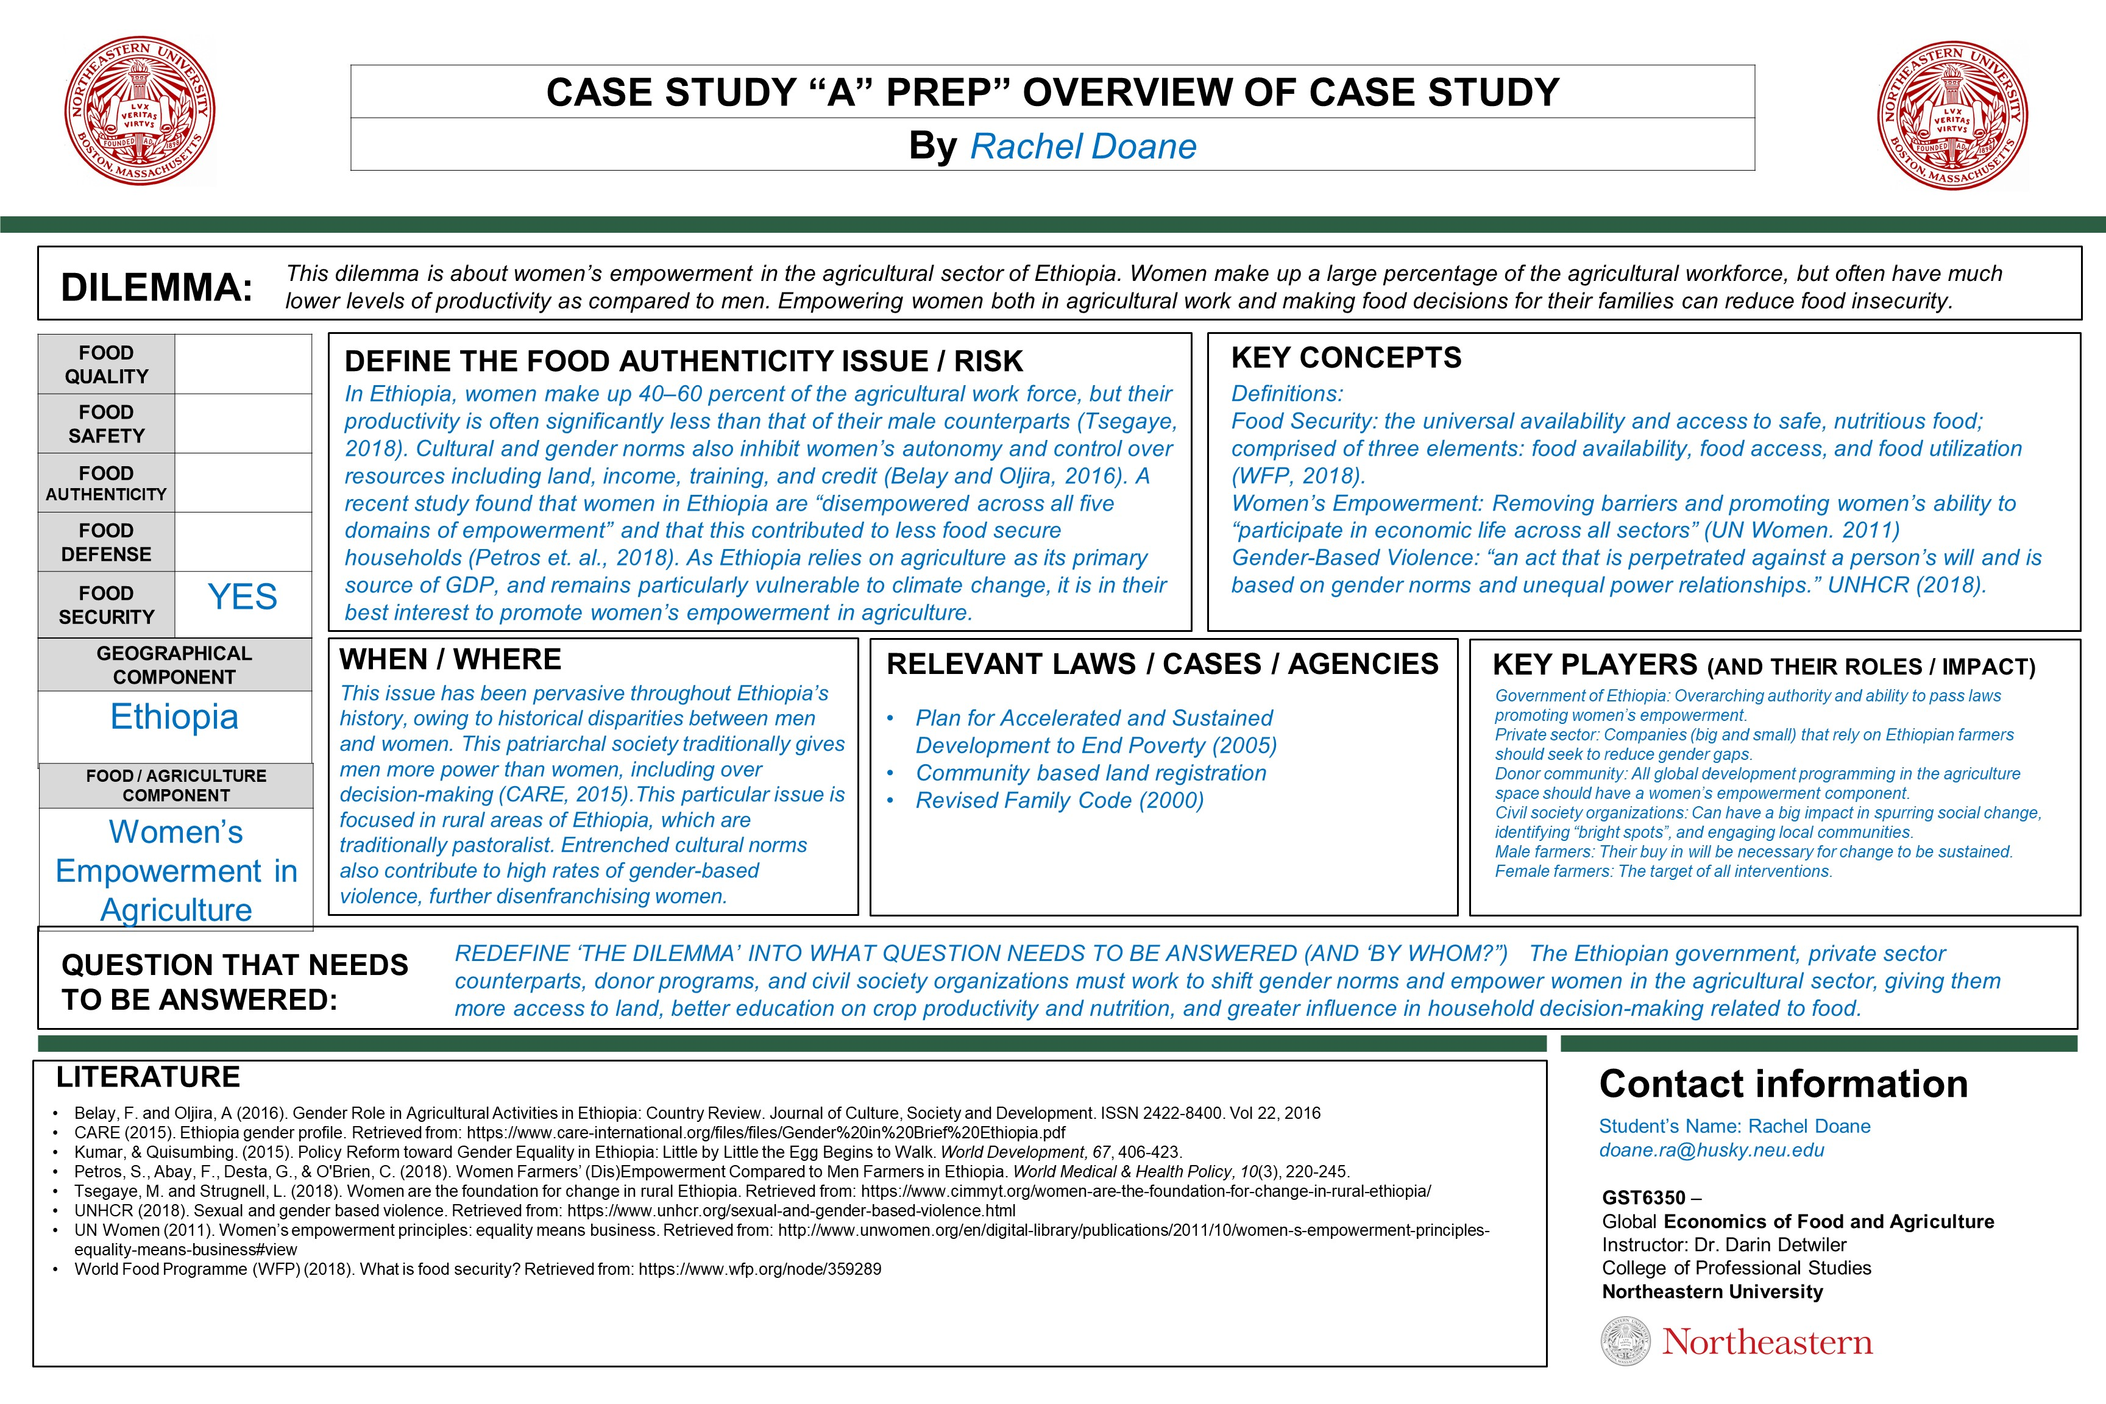
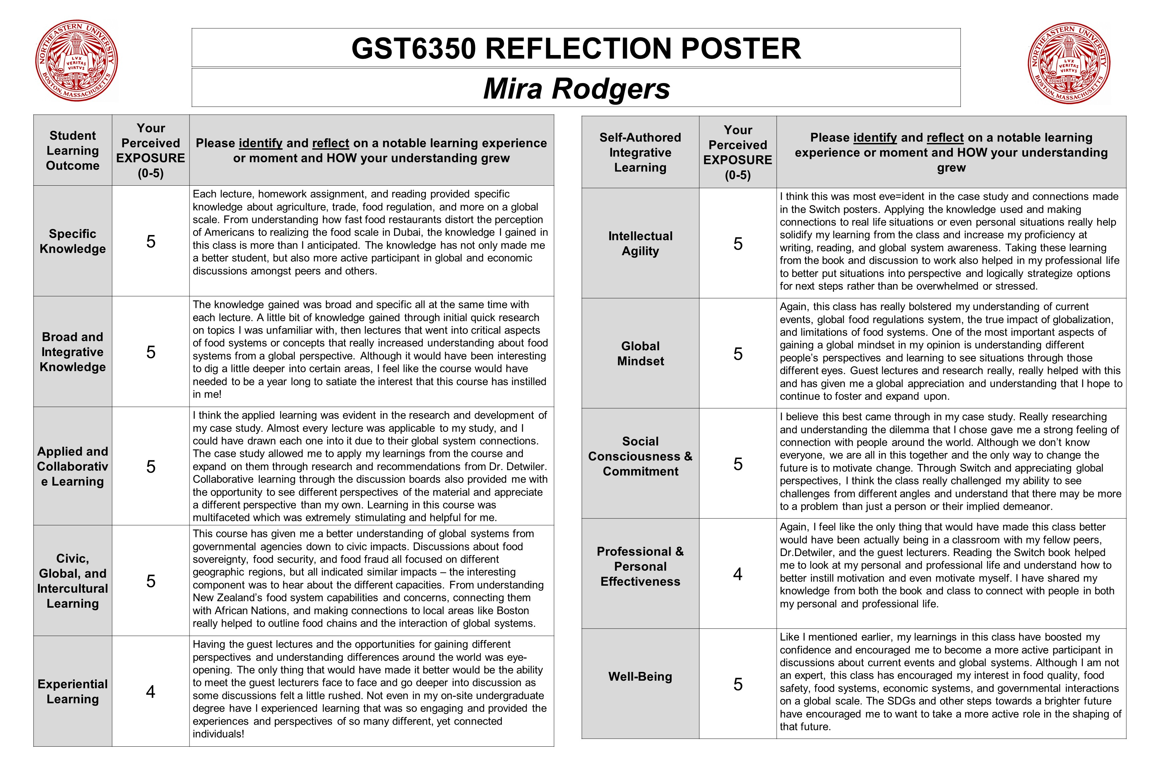
EXAMPLES
instructor engagement, assessment of prior learning, building a community of learners, supporting student success
Week THREE:
Use in own Discussion Board Thread. (Serves as a means to have students define topic, apply SSPs, identify intended process for research, and share with other students. Builds community of learners and supports student success.)
Week TWO weeks before Paper due:
Use in own Discussion Board Thread. (Serves as a means to have students expand topic, highlight key questions for paper. Builds community of learners and supports student success by having students not waiting until last minute to start writing their paper.)
FINAL Week:
Use in own Discussion Board Thread. (Serves as a means to have students reflect on their perceived exposure in the course to specific Student Learning Outcomes and on the various SAIL dimensions. Gives instructor great insights.)

Slide 5
“I like working on the posters because it helps to put my thoughts together for papers.”
“I love seeing others’ posters.”
THANK YOU FOR ATTENDING TEXPO 2019!
“The after posters were very interesting to see how other students viewed the same subject and what they took from it. The discussions that derived from the POSTERS were also very collaborative and respectful, as well as enthusiastic.”
“These POSTERS are such effective ways of communicating.”
“After the POSTERS, I used all of the comments that were given to me from classmates and the instructor to succeed and complete the main product.”
Darin Detwiler, LP.D., M.A.Ed.
Assistant Dean, College of Professional Studies, Assistant Teaching Professor

