Slide 1
FEEDBACK SESSION: EXPLORING VIRTUAL COMPUTING ENVIRONMENTS FOR TEACHING AND LEARNING

Slide 2
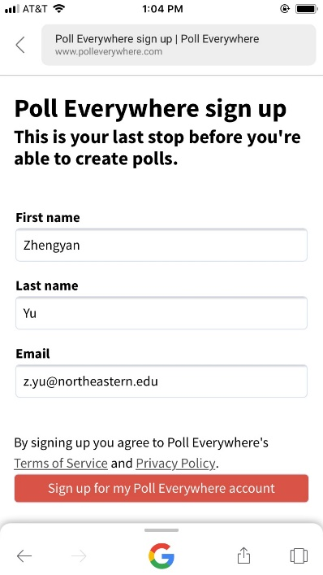
Poll Everywhere
We will be using Poll Everywhere for the feedback portion of this session. Please follow the steps below to login as a participant.
Step 1: On a phone or laptop, log into http://northeastern.edu/ats/pollev with your myNortheastern portal credentials
Step 2: Scroll down and click
Step 3: Confirm that you see your dashboard
URL bar
Step 4: Type the survey URL into the URL bar PollEv.com/virtual and choose your answer
Notes:
What are your top three barriers (if any) to your use of technology for teaching and learning?

Slide 3
Notes:
What do you hope to learn, share, or takeaway from this session?
https://www.polleverywhere.com/free_text_polls/YtEMqith8YWqerycBB8TV

Slide 4
Panelists and Feedback Facilitators
Moderator: Clair Waterbury, Academic Technologies, Information Technology Services
CPS Needs Analysis and Piloting of Virtual Computing Solutions
Khoury College use of VM Ware and Chromebooks
Information Technology Services
Beth Rochefort
Online Experiential Learning
Jon Frederick
Khoury College of Computer Sciences
Matt Wilson
Asst. Dir. Microsoft Sys Admin - ITS
Xiaomu Zhou
College of Professional Studies
Anthony Grutta
Dir. d.Studio - ITS
Notes:
For those of you that don’t know the full catalog of services and support X
What is different –
integrated technology support with NUonline and all global and regional campuses
AV design and support now in AT supporting global campuses and regional
More custom solutions and support models for programs and individuals
Alignment for better synergies
Alignment for better enablement
Looking at learning physically, virtually and globally as an inclusive ecosystem

Slide 5
Feedback Session Goals
Audience will receive advice and gain insight from current pilot coordinators and ITS for virtual computing environments for teaching and learning
ITS and project team will better understand use cases and needs for virtual computing environments for teaching and learning
Encourage audience who are interested to connect with ITS team members to experiment with potential solutions
Notes:
As Stephanie mentioned in her Northeastern Learning Environment 2025 conversation, we need you! We need your in put, we need to understand your use cases, and we need willing participants to test out solutions. The Feedback Session title designates that Information Technology Services is still investigating solutions, so attendees will be able to talk through their use cases for virtual computing environments in the teaching and learning space and get advice from current pilot coordinators and ITS Systems team members.
There is a lot around the virtual computing conversation, however for this session we are focusing specifically on teaching and learning uses. In a minute I will explain what we mean by virtual computing environment and talk through some of the examples.

Slide 6
Needs for a Virtual Computing Environment
When understanding the needs around a Virtual Computing Environment for teaching and learning we are thinking about needs for:
Access to virtual environments with licensed and free software
Access to virtual cloud environments such as servers, AWS Educate, Azure Dev Labs, Google Cloud, high powered virtual machines, etc.
Support and integration for these environments
Features required for teaching in these environments
Notes:
The key piece here is the teaching in these environments:
We know that with teaching access can vary. From semester to cross semester for projects. We need to understand what else might be important to you.

Slide 7
Notes:
What are your teaching and learning use cases for virtual computing environments? Please add as many as you would like and up vote those that you have the same need for.
https://www.polleverywhere.com/discourses/uSDYzvwjKcull0MUAXbsZ

Slide 8
Notes:
What are you already using? For example, AWS educate, Azure Notebooks, Git Hub, Git Hub Classroom, Google Cloud, Azure, App Cloud, etc.
https://www.polleverywhere.com/discourses/YI6Lx3EozYVafFTwX2dnA

Slide 9
Notes:
For your ideal virtual computing solution which of the following features are important to you:
https://www.polleverywhere.com/multiple_choice_polls/zYpf04ZJyJ1JyWSGTVLrW

Slide 10
Notes:
For you to teach in virtual computing environments, which of the following features are needed:
https://www.polleverywhere.com/multiple_choice_polls/zIdOTOm5RPeRlkhRB9k8F

Slide 11
Notes:
What additional support would you like to see for our virtual computing environment?
https://www.polleverywhere.com/discourses/HbyDMhG9eFCDQSb82Nz3K

Slide 12
Notes:
Please share any additional thoughts/information.
https://www.polleverywhere.com/free_text_polls/N492VhIjjgVyRQz734u5X

Slide 13
THANK YOU FOR ATTENDING TEXPO 2019!

