Slide 1
Office 365 Teams for Teaching and Learning
Kat Gonso Associate Teaching Professor, English Department

Slide 2
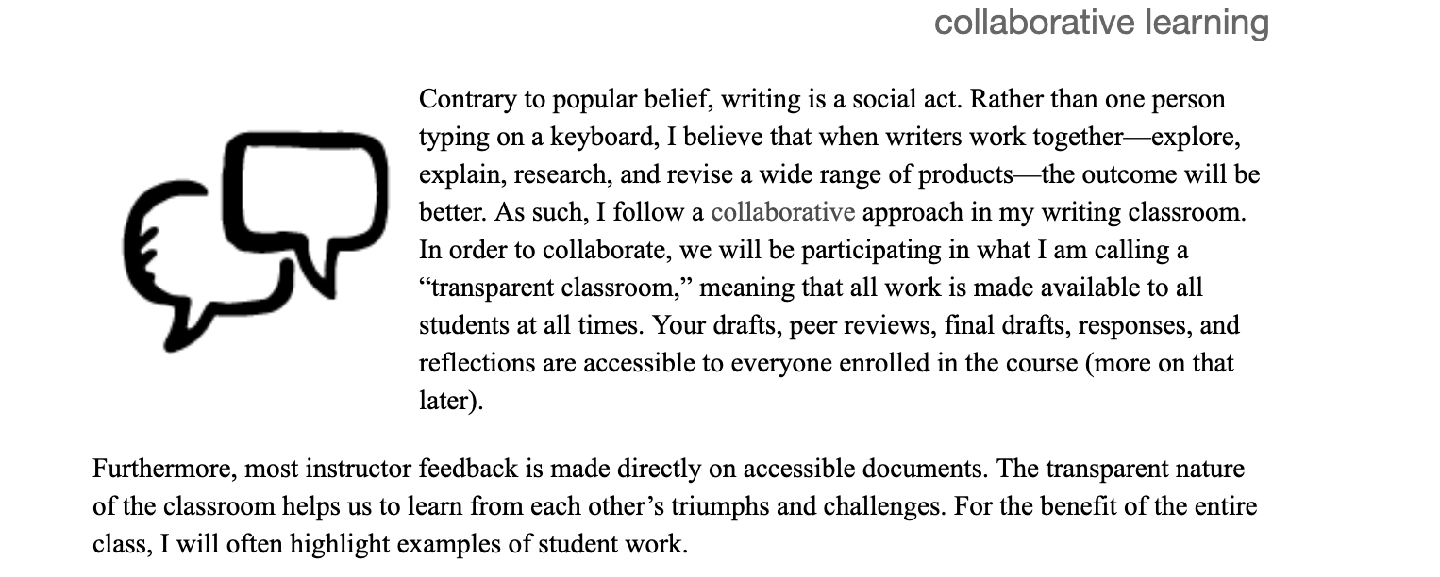

Slide 3
The College Composition and Communication Position Statement of Principles and Example Effective Practices for Online Writing Instruction states that “appropriate onsite composition theories, pedagogies, and strategies should be migrated and adapted to the online instructional environment.”

Slide 4
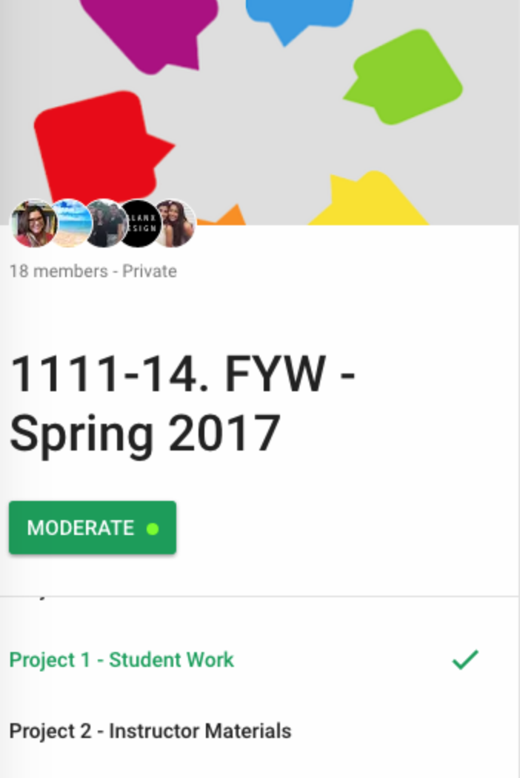
Google + Communities
-Untapped platform
-Private
-Transparent
-Google docs and Drive
-Less email
-Lots of set-up

Slide 6
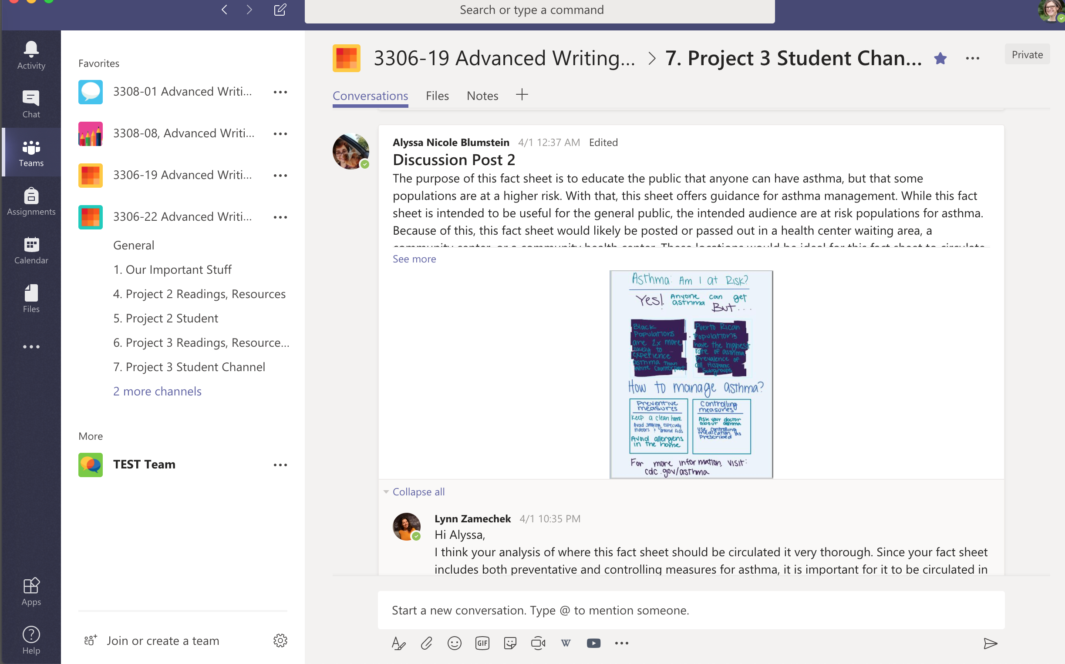

Slide 8
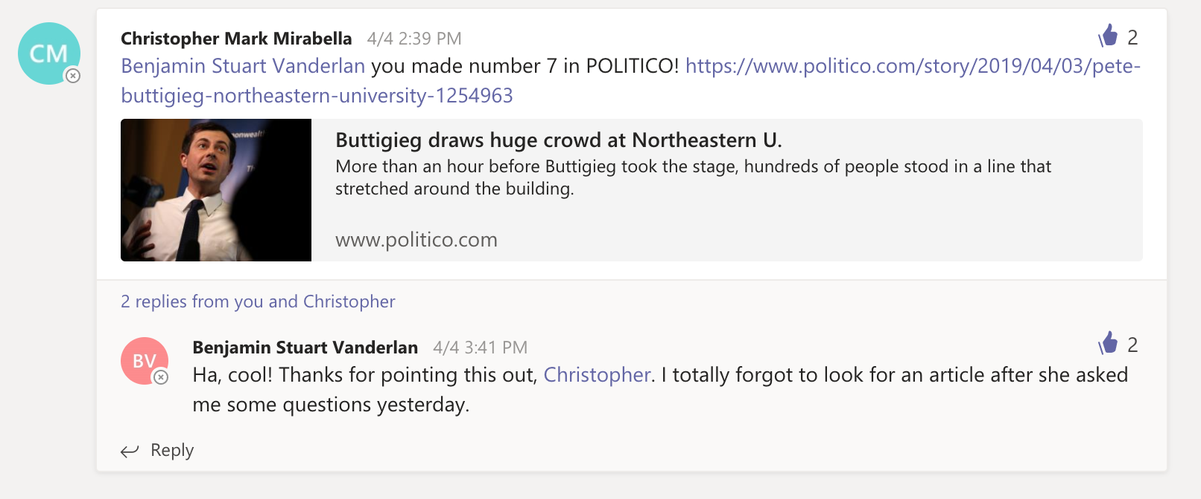

Slide 9
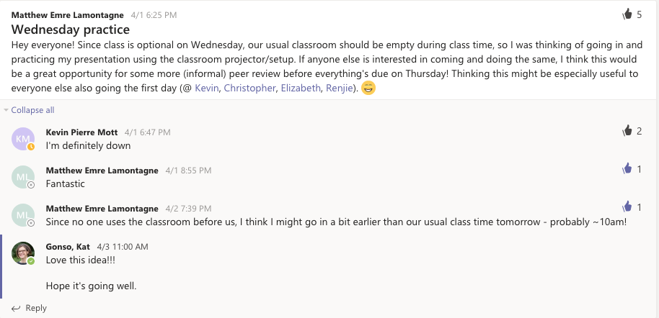

Slide 10
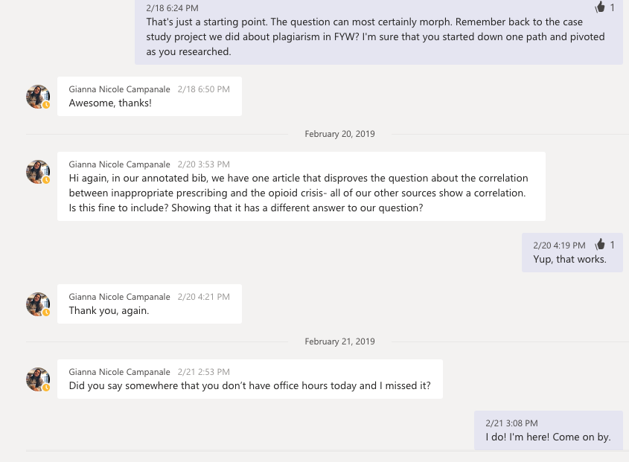

Slide 11
Student Feedback - Cons
Learning curve
Want one system for the university
Hard to search for files / scrolling / clunky
Too many notifications
Can’t change student or instructor names

Slide 12
Student Feedback - Pros
Communicating
Collaborating
Connecting

Slide 13
Pros and Cons for Instructors
Cons
Huge learning curve
Setting boundaries
Student resistance
3 LSMs
Pros
ATS and NU support
Chat, video, screenshare
Multimodal and visually pleasing
Transparent
Achieved goals (communicating, connecting, and collaborating)

