Slide 1
Leveraging Blackboard’s Hidden Features in an Educational Study: a Use case
Andrew Mackie, MPAS, PA-C
April 9, 2019

Slide 2
Overview
Goal
Study Design
Leveraging Blackboard’s Tools

Slide 3
Goal
X

Slide 4
Study Design -EKG interpretation for PA students
Fall: course
Spring/summer:
Outcomes/data
Didacic EKG course
n=46
Weekly practice EKG (=46)
1.) Baseline exam
(end of course)
2.) Competency exam
(end-of-semester)
3.) Survey results (weekly)
Quantitative (Likert)
Qualitative
(student comments)
Randomized feedback
Written key
(n=23)
Video key
(n=23)

Slide 5
Study Design -EKG interpretation for PA students
Data sources
Exam data
Semester 1 course grades
Semester 2 competency exam
Semester 3 competency exam
Weekly survey data (2nd & 3rd semesters)
1.) Attestation (yes/no)
2-4.) Likert questions
5.) Qualitative (brief student comments)
_{Blackboard: GRADE CENTER}
_{Blackboard: SURVEY}

Slide 6
Blackboard Tools -spring/summer
Groups: basic set up
Groups: Smart views
Assignment: adapive release
Survey: statistics tracking
Tegrity
Key: adaptive release (by group)

Slide 7
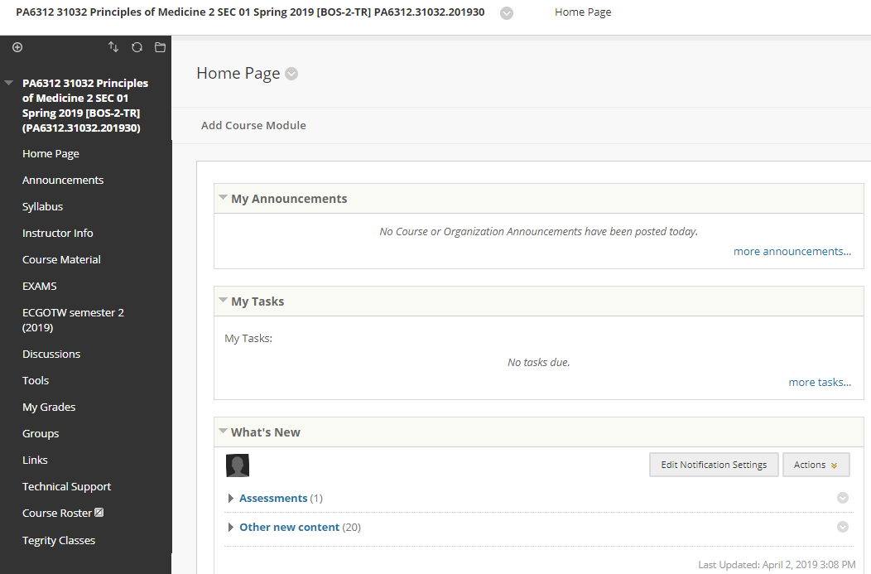
Blackboard Tools -spring/summer
Groups: basic set up
Groups: Smart views
Assignment: adapive release
Survey: statistics tracking
Tegrity
Key: adaptive release (by group)

Slide 8
Blackboard Tools -spring/summer
Groups: basic set up
Groups: Smart views
Assignment: adapive release
Survey: statistics tracking
Tegrity
Key: adaptive release (by group)

Slide 9
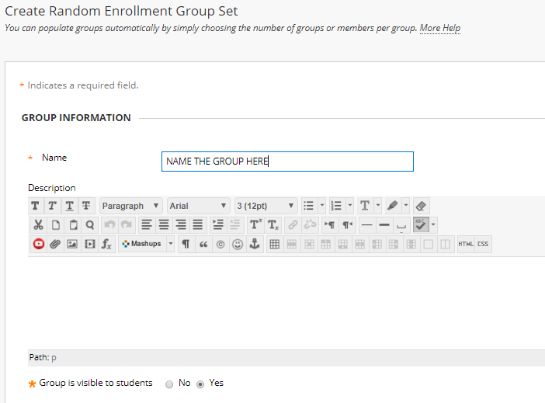
Blackboard Tools -spring/summer
Groups: basic set up
Groups: Smart views
Assignment: adapive release
Survey: statistics tracking
Tegrity
Key: adaptive release (by group)

Slide 10
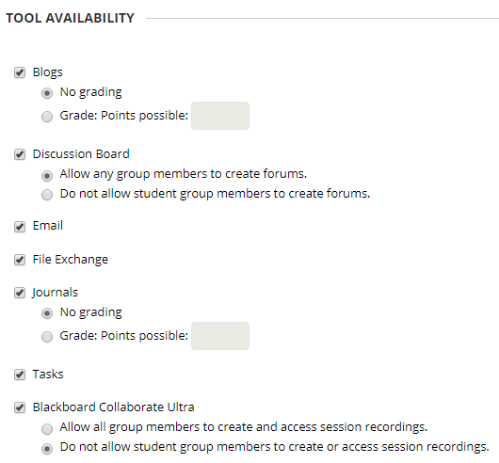
Blackboard Tools -spring/summer
Groups: basic set up
Groups: Smart views
Assignment: adapive release
Survey: statistics tracking
Tegrity
Key: adaptive release (by group)

Slide 11
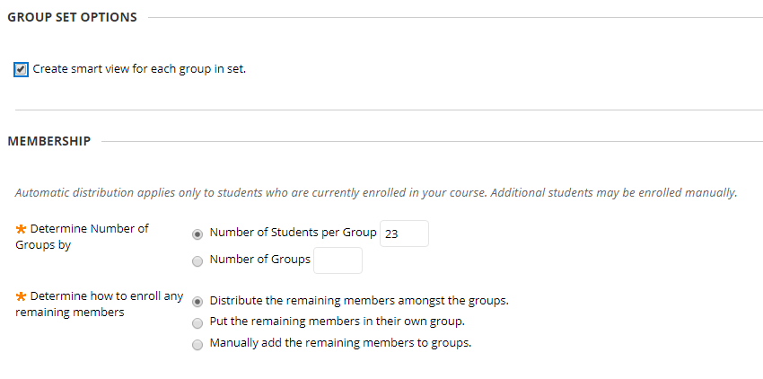
Blackboard Tools -spring/summer
Groups: basic set up
Groups: Smart views
Assignment: adapive release
Survey: statistics tracking
Tegrity
Key: adaptive release (by group)

Slide 12
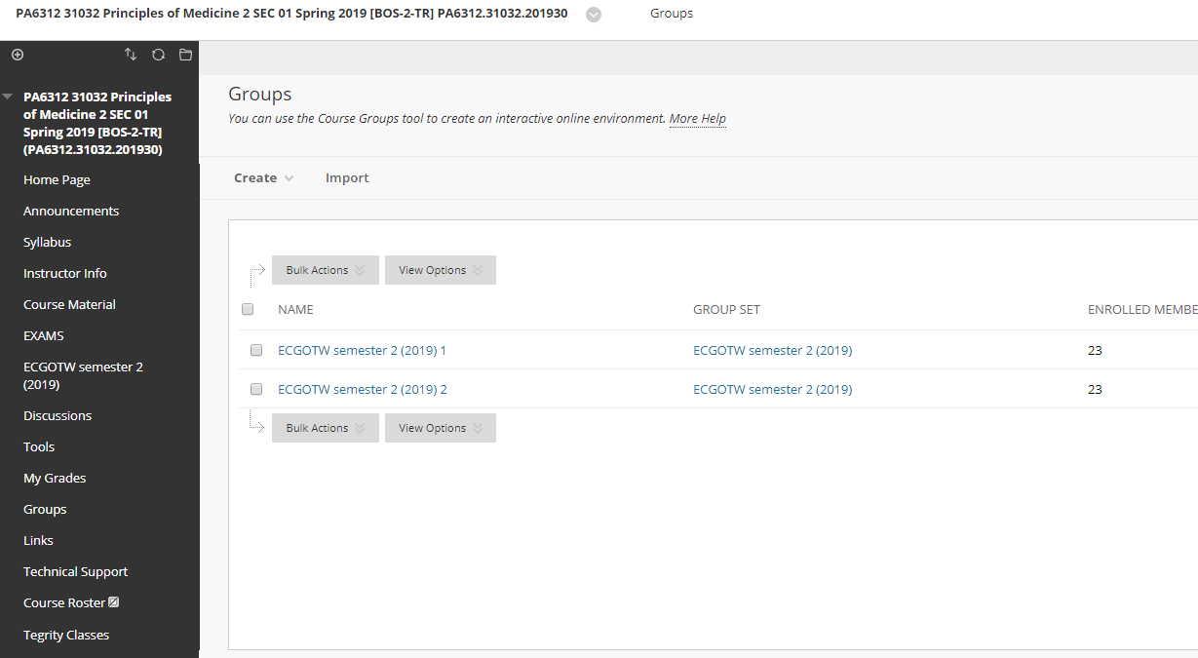
Blackboard Tools -spring/summer
Groups: basic set up
Groups: Smart views
Assignment: adapive release
Survey: statistics tracking
Tegrity
Key: adaptive release (by group)

Slide 13
Blackboard Tools -spring/summer
Groups: basic set up
Groups: Smart views
Assignment: adapive release
Survey: statistics tracking
Tegrity
Key: adaptive release (by group)

Slide 14
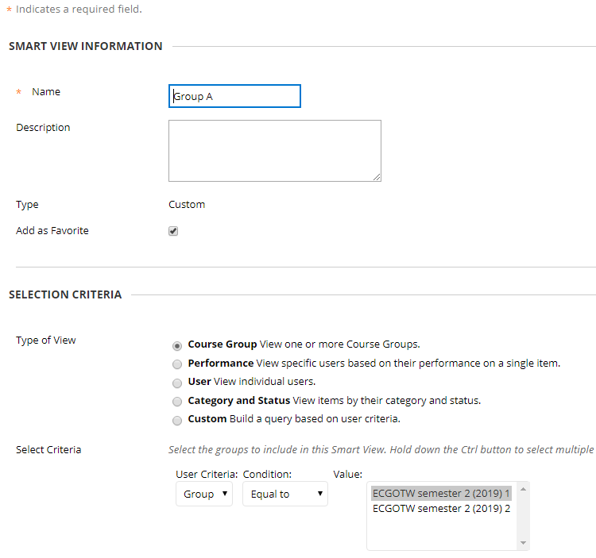
Blackboard Tools -spring/summer
Groups: basic set up
Groups: Smart views
Assignment: adapive release
Survey: statistics tracking
Tegrity
Key: adaptive release (by group)

Slide 15
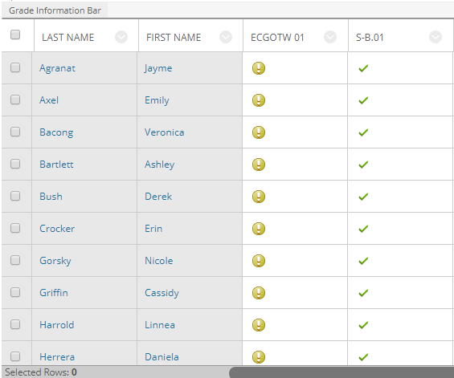
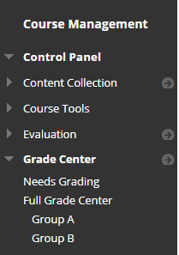
Leveraging Blackboard’s Tools “Smart Views”
_{GROUP A}
_{GROUP B}
_{Assignment 1}
_{Assignment 1}
_{Survey B}
_{Survey A}

Slide 16
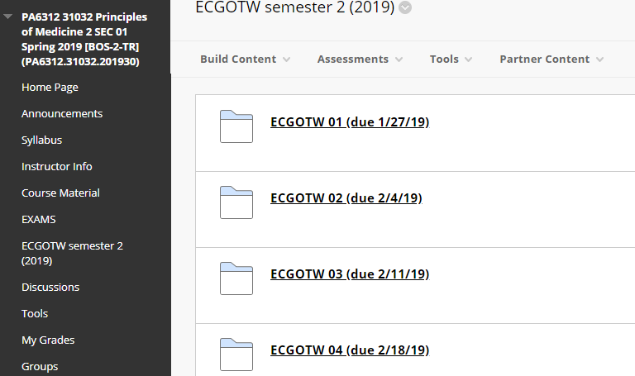
Blackboard Tools -spring/summer
Groups: basic set up
Groups: Smart views
Assignment: adapive release
Survey: statistics tracking
Tegrity
Key: adaptive release (by group)

Slide 17
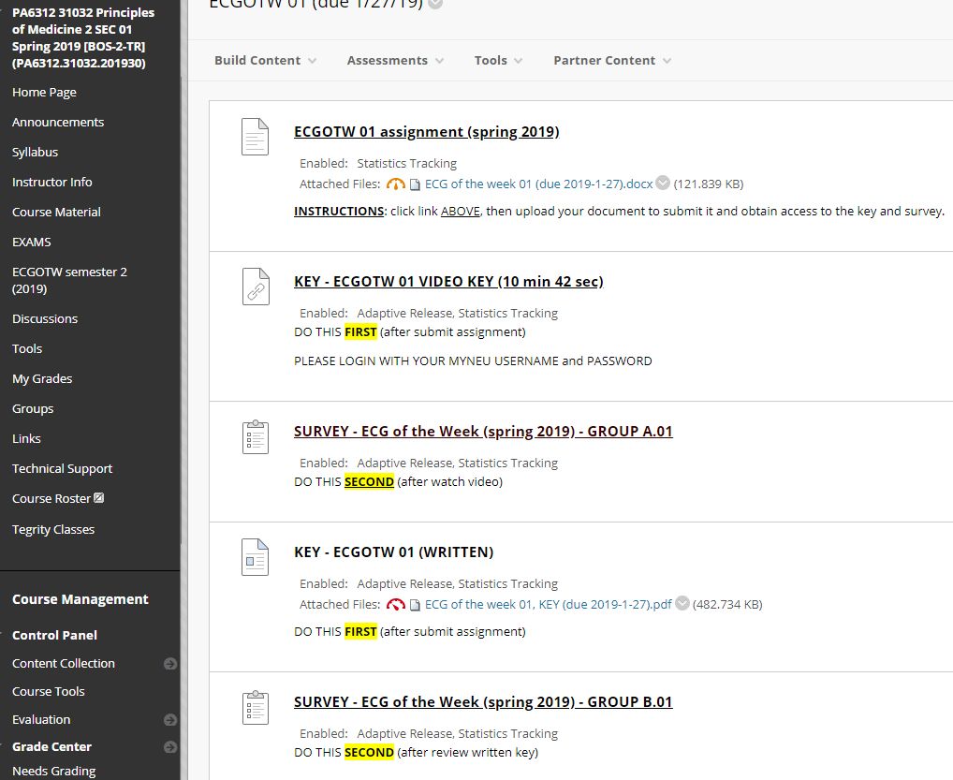
Leveraging Blackboard’s Tools -Adaptive Release
_{Assignment}
_{Group A only sees this}
_{Group A}
_{-Key}
_{-Survey}
_{Group A}
_{(after submit assignment)}
_{Group B}
_{Group B}
_{-Key}
_{-Survey}
_{(after submit assignment)}

Slide 18
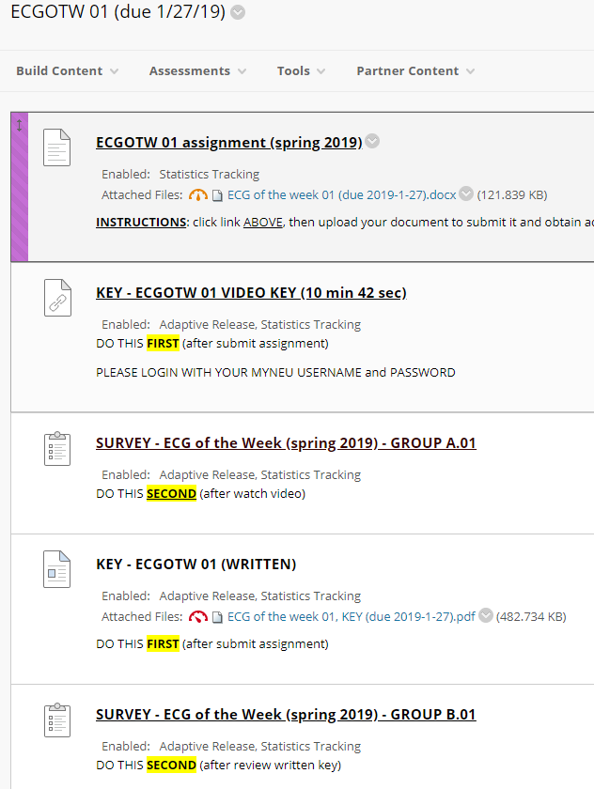
Blackboard Tools -Adaptive Release
Groups: basic set up
Groups: Smart views
Assignment: adapive release
Survey: statistics tracking
Tegrity
Key: adaptive release (by group)

Slide 19
Blackboard Tools -Adaptive Release
Groups: basic set up
Groups: Smart views
Assignment: adapive release
Survey: statistics tracking
Tegrity
Key: adaptive release (by group)

Slide 20
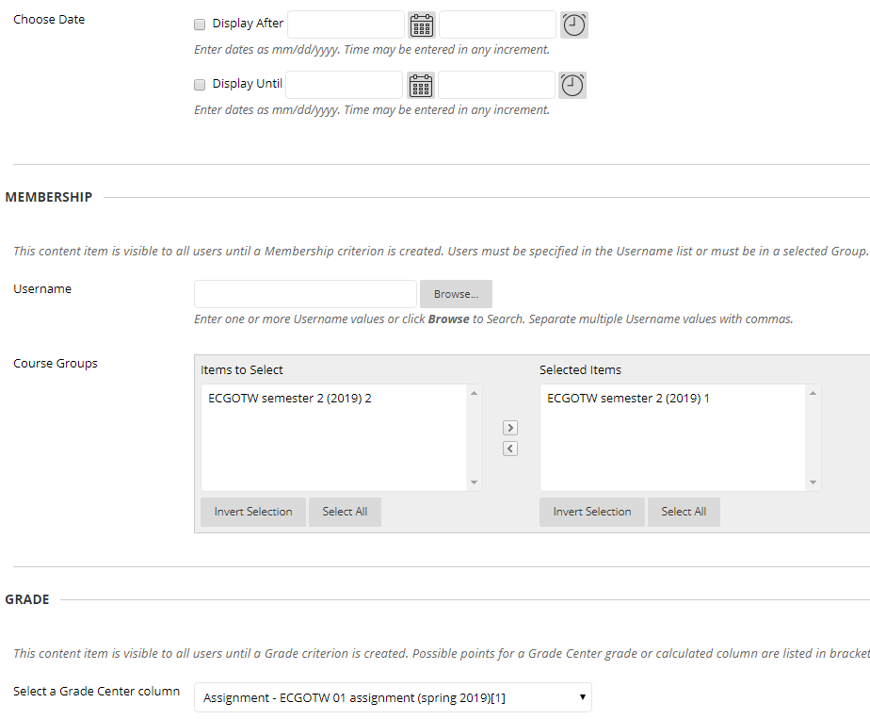
Blackboard Tools -Adaptive Release
_{Group A}
Groups: basic set up
Groups: Smart views
Assignment: adapive release
Survey: statistics tracking
Tegrity
Key: adaptive release (by group)

Slide 21
Blackboard Tools -Adaptive Release
Groups: basic set up
Groups: Smart views
Assignment: adapive release
Survey: statistics tracking
Tegrity
Key: adaptive release (by group)
_{Group B}

Slide 22
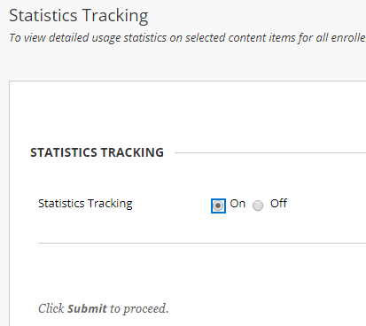
Blackboard Tools -Statistics tracking
Statistics Tracking
To view detailed usage statistics on selected content items for all enrolled users, turn on Statistics Tracking. Statistics Tracking must be turned on for each individual item to be tracked. The default setting for Statistics Tracking is off. More Help
Groups: basic set up
Groups: Smart views
Assignment: adapive release
Survey: statistics tracking
Tegrity
Key: adaptive release (by group)

Slide 23
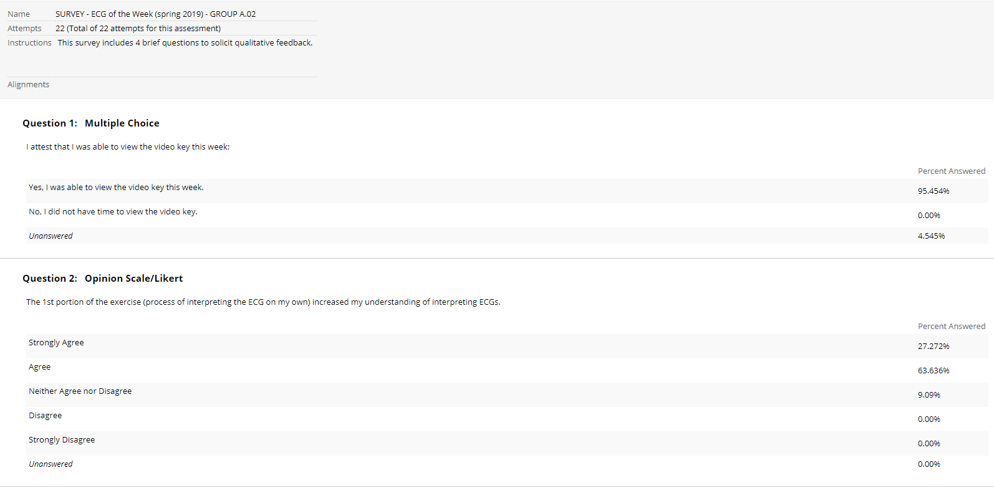
Leveraging Blackboard’s Tools -Statistics tracking (survey results)

Slide 24
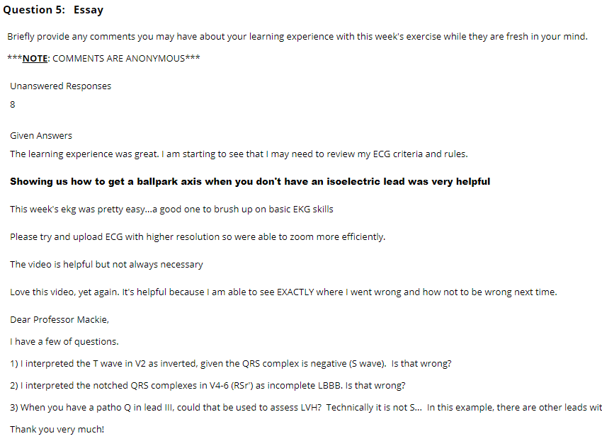
Leveraging Blackboard’s Tools -Statistics tracking (survey results)

Slide 25
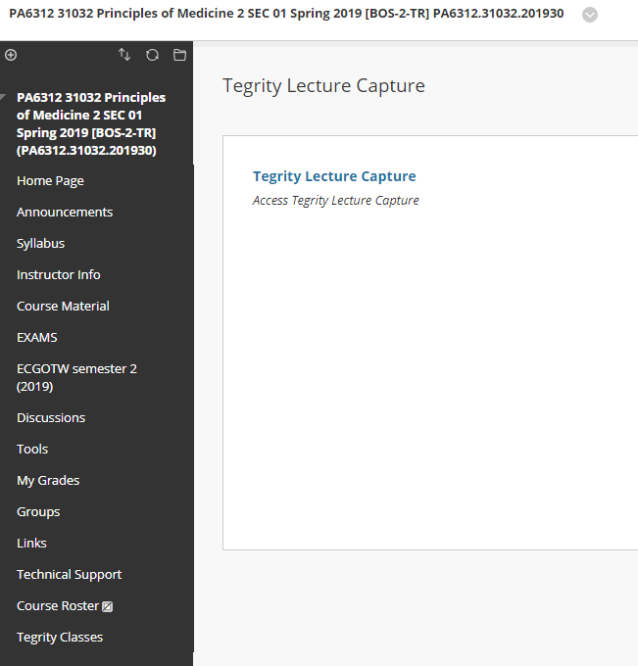
Blackboard Tools -spring/summer
Groups: basic set up
Groups: Smart views
Assignment: adapive release
Survey: statistics tracking
Tegrity
Key: adaptive release (by group)

Slide 26
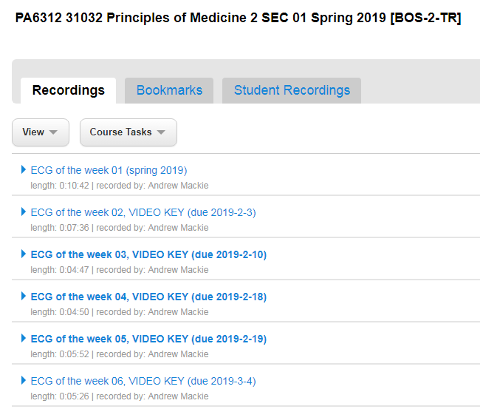
Blackboard Tools -spring/summer
Groups: basic set up
Groups: Smart views
Assignment: adapive release
Survey: statistics tracking
Tegrity
Key: adaptive release (by group)

Slide 27
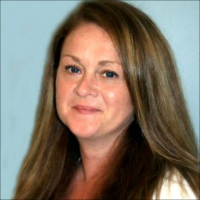
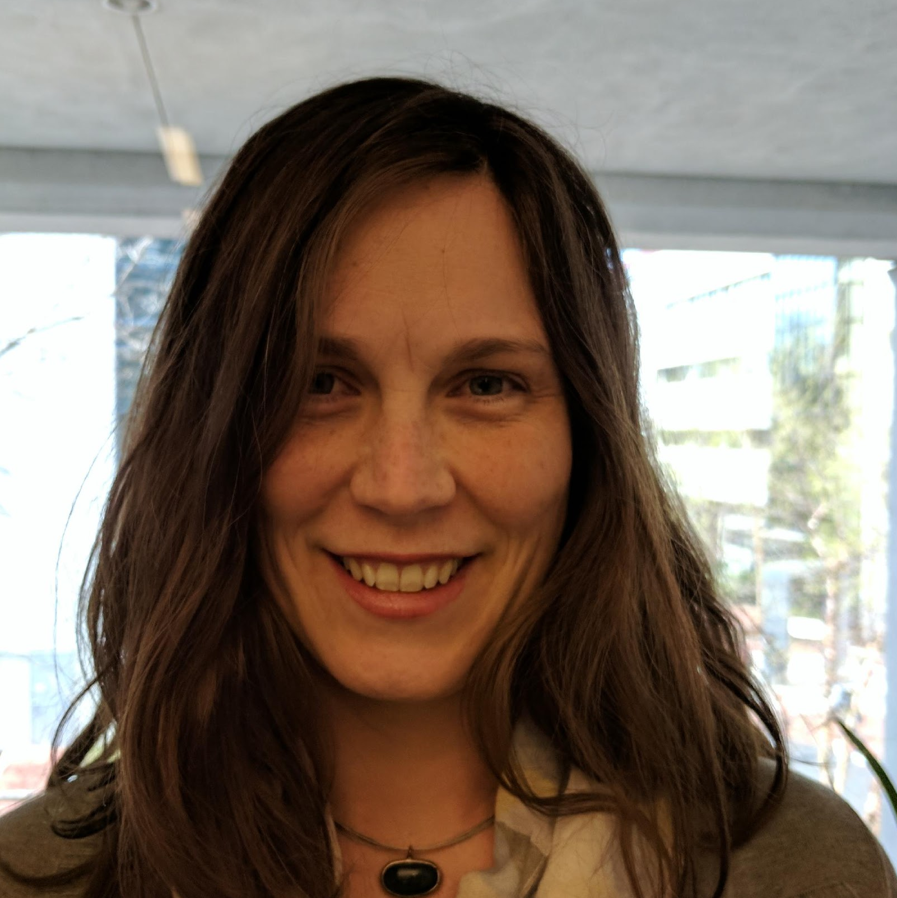
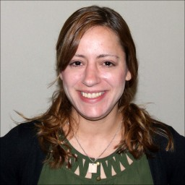
ATS Team!
Stephanie Trowbridge
Interim AVP - ATS and CS
Lindsey Sudbury
Sr. Academic Instructional
Technologist
Chris Carrillo
Asst. Director, Integrated Learning Systems
Terry Beadle
Sr. Academic Instructional
Technologist
Jesse Savage
Systems Administrator
Clair Waterbury
Academic Instructional
Technologist
Alyssa Faria
Academic Instructional
Technologist

Slide 28
Questions?

