Slide 1
Leganto
Library software that makes course materials
more accessible and easier to manage

Slide 2
Create lists of course materials:
Easy to create lists with drag-and-drop, no cutting and pasting of unreliable links!
Upload your own PDF’s
Create links to any website
Tag items for recommended student or library purchase

Slide 3
Drag and Drop
Right: Scholar OneSearch window
Left: Course reading list

Slide 4
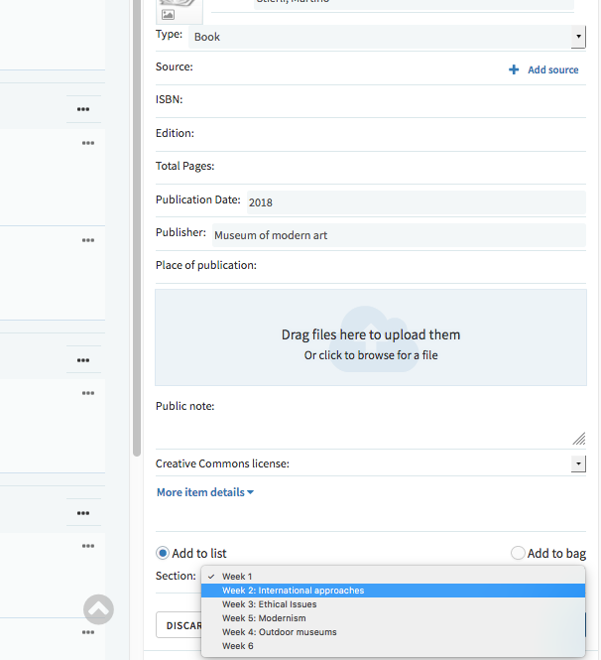
Upload your own PDF

Slide 5
Add website links
Blogs and other online readings
YouTube Videos
Free e-books or online libraries
Recommended purchases from Amazon or the NU bookstore
Any website can be linked!

Slide 6
Use tags to:
Indicate to students that something is required or suggested viewing/reading
Indicate to the library you wish the item to be purchased

Slide 7
Advantages for instructors
Self-service Blackboard integration
Access control through Blackboard
View: class only, NU only, or public view
Administer: TA’s automatically authorized to manage lists
Data available on which resources are used

Slide 8
Advantages for students
Reliable links:
Students report problems directly to the library
Library maintains and troubleshoots links
Cost savings: leverages already-licensed library materials
Transparency: students can learn prior to enrollment what the readings will be

Slide 9
Questions? Contact Us
Evan Simpson, Associate Dean, Research and Learning Services e.simpson@northeastern.edu
Erin Beach, Course Reserves Coordinator e.beach@northeastern.edu

