Slide 1
Removing Barriers
Academic Technology Services

Slide 2
Lead, follow, or...

Slide 3
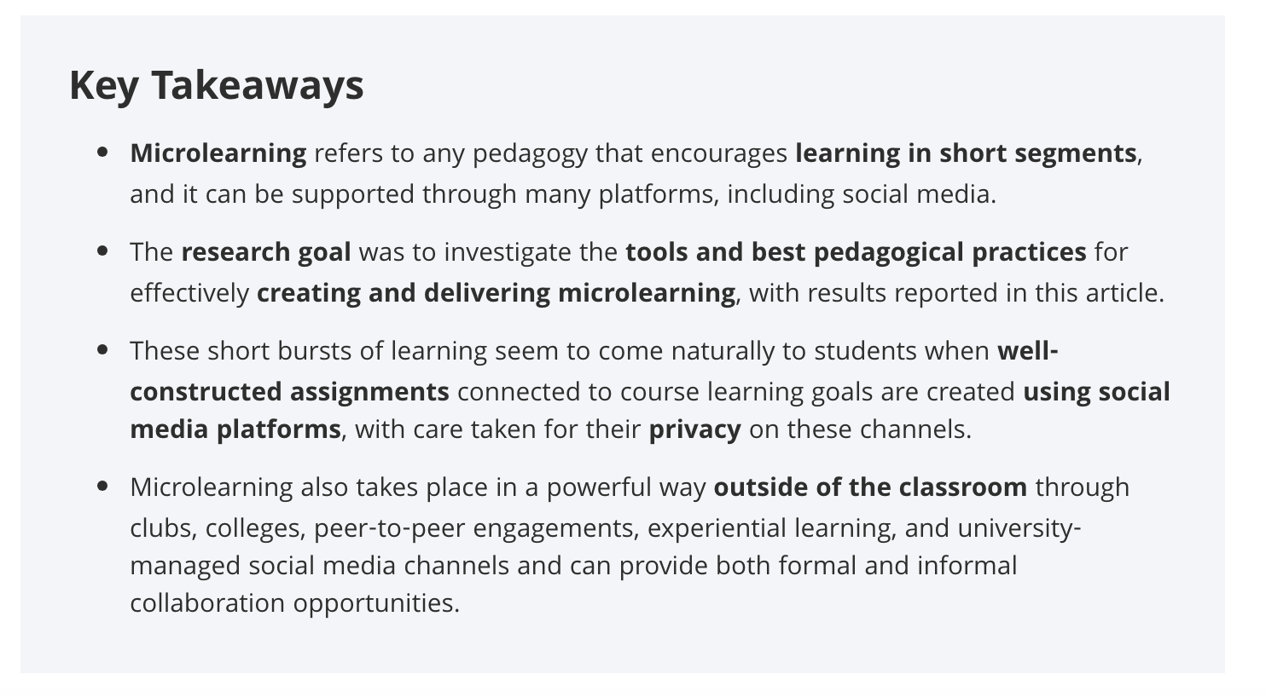
Leading
Educause article on Social Microlearning

Slide 4
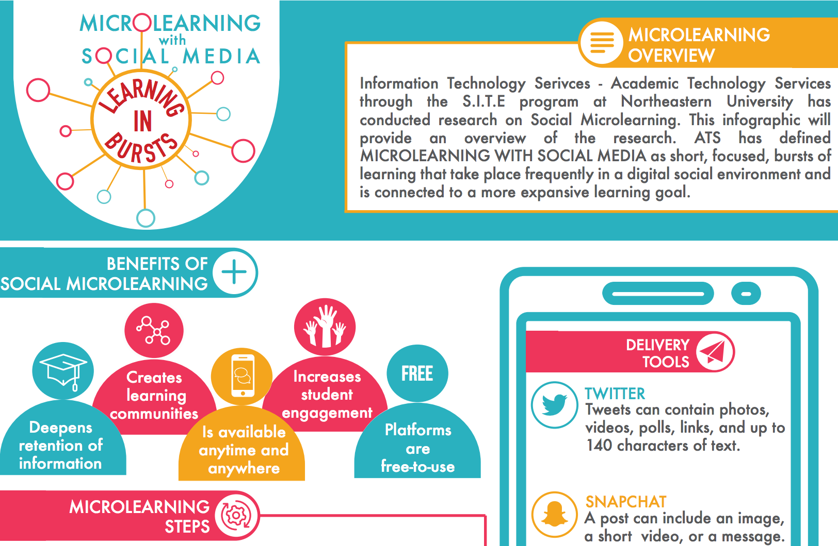
Leading
Educause article on Social Microlearning

Slide 5
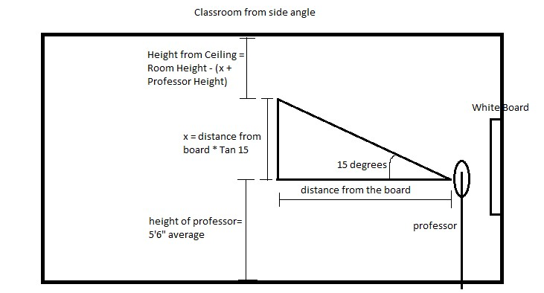
Leading
UB Tech Presentation: Camera Placement App

Slide 6
Following

Slide 7
Partnerships and information sharing
Breaking down silos: Attendees
On ground “day school” faculty
Many departments
Staff from library, administrative, teaching and learning support offices
CPS, PAN
Many attendees work in more than one category

Slide 8
Partnerships and information sharing
Breaking down silos: Our work
Faculty
Students
ITS
Customer Service
CATLR
Library
PAN, NUOEL, DMSB IDG
Everyone else!
Notes:
Teaching and learning innovation comes from faculty at Northeastern. Thanks to the faculty who have piloted with us, faculty who are speaking today, Faculty Senate, faculty who worked on ITS Strategy with us
We’re all here because of the students (shoutout to SITE program)
Structure and support of Information Technology Services and Rehan Khan
Backed up by ITS Customer Service (help@northeastern.edu x4357)
Grounded by the work that CATLR does
Enhanced by working alongside librarians (P.S. talk to the library about adding the librarian role to your courses!)
Partnerships/resource sharing with staff doing similar work: PAN, NUOEL, DMSB IDG
Everyone else!

Slide 9
Learning together...Today’s key takeaways
Insert Poll Everywhere results

Slide 10
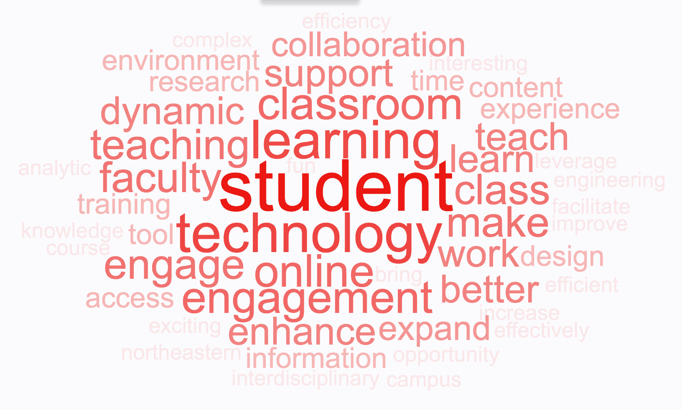
Shared goals
What are your top three reasons (if any) for wanting to use technology for teaching and learning?

Slide 11
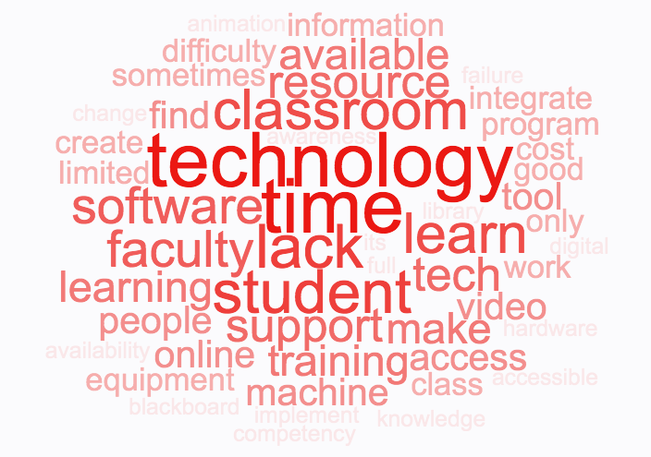
Identifying barriers
What are your top three barriers (if any) to your use of technology for teaching and learning?

Slide 12
Barrier 1: Cost/Access
“Access to tools”
“Software licenses”
“Access/limited resources”
You said....
“Corporate firewalls and byzantine offerings”
“Licensing”
“Lack of current technology relative to what students use outside of the classroom”

Slide 13
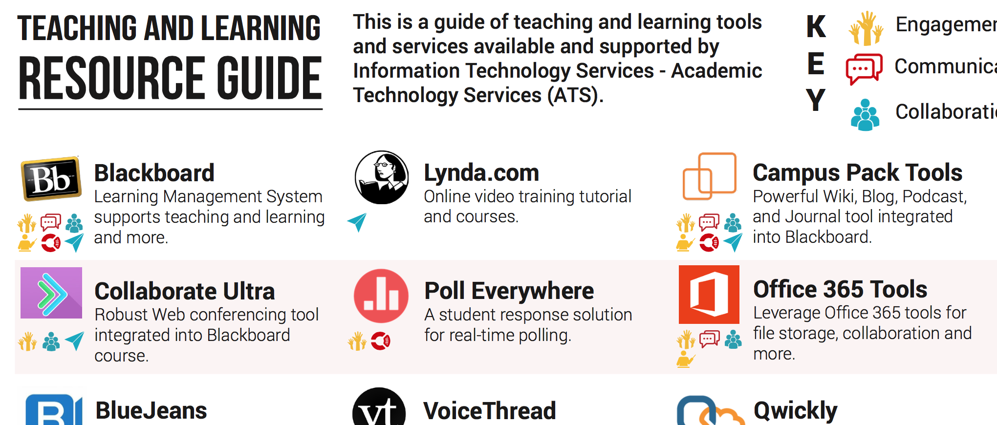
Integrative/Holistic Approach
Ask for admin rights!
Notes:
Learning management system
Productivity software
Academic honesty software with grading support
E-portfolios
Interactive online modules
Video or lecture capture and streaming
Web conferencing
Design + Data + other non “edtech” tools
Interactive video
Student response
Attendance tracking
Survey tools
Can be used together or independently. Many support a variety of different formats. add a quick story about the barriers of using models like the flipped classroom, online or hybrid and talk about some of the services we support to break down their barriers?
Specialty software
Imaged machines:
https://www.northeastern.edu/its/standard-configuration/
Non-imaged machines:
https://www.northeastern.edu/its/general-access/

Slide 14
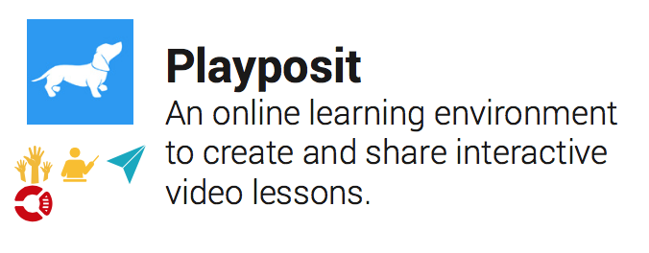
New tools this year
Interactive video
Notes:
Interactive video
Student response
Attendance tracking
Survey tools

Slide 15
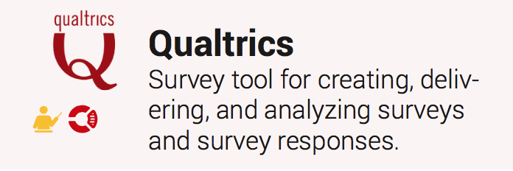
New tools this year
Survey tools
Notes:
Interactive video
Student response
Attendance tracking
Survey tools

Slide 16
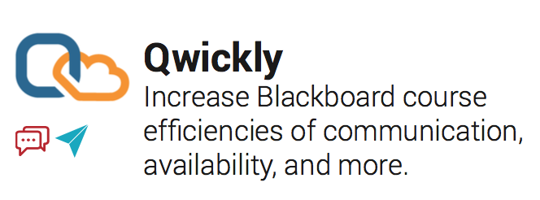
New tools this year
Attendance and communication tools
Notes:
Interactive video
Student response
Attendance tracking
Survey tools

Slide 17
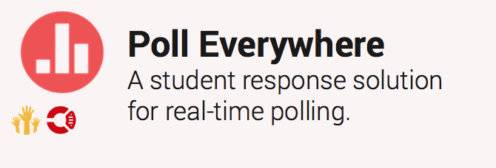
New tools this year
Student response
Notes:
Interactive video
Student response
Attendance tracking
Survey tools

Slide 18
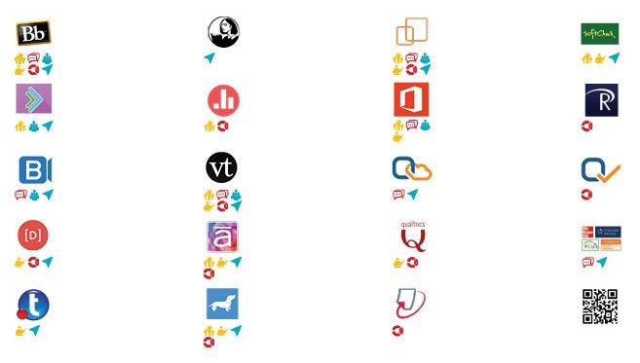
Integrative/Holistic Approach
Coherent catalog of tools
Learning management system
Productivity software
Academic honesty software with grading support
E-portfolios
Interactive online modules
Video or lecture capture and streaming
Web conferencing
Design + Data + other non “edtech” tools
Interactive video
Student response
Attendance tracking
Survey tools
Notes:
Can be used together or independently. Many support a variety of different formats. add a quick story about the barriers of using models like the flipped classroom, online or hybrid and talk about some of the services we support to break down their barriers?
Check software availability on the ITS website

Slide 19
Understanding what is meaningful
Technology not an end in itself
Supports authentic learning
Meets objectives
Supports learning rather than detracts
Implementation meets objectives

Slide 20
Understanding what is meaningful
Vendors make technology; you make it meaningful + supportive of learning
Notes:
We are technologists who love teaching and learning, and we are all battling against shiny object syndrome.

Slide 21
“Supported software”
What it means
Free
Overall value
Single sign-on
Secure
Blackboard integration
Support
Life cycle considered
Notes:
Licensing makes it free for Northeastern students and faculty (usually)
Has been vetted and overall value is better than similar tools in class (optimization for general use; relatively intuitive interface)
Generally: single sign on is configured so that students and faculty don’t need to create an account
Security risks considered
Integration into Blackboard (if available)
Documentation and training is provided; Help desk is familiar with most common issues with the tool
Life cycle considered: what happens when it no longer meets requirements of the university?

Slide 22
“Not supported”
What it means
Consider security
Get ahead of student questions
Get admin rights on your computer
Have fun
Notes:
We want you to love your technology and and will help you as best we can
Consider whether grades are being stored on vendor servers and what information students are required to provide
Think ahead: Let’s talk to identify strategies for aggregating support documentation and vendor support contact ahead of time so that students won’t be frustrated
Get admin rights on your computer so you can install necessary software
We usually love it too; just sometimes it’s not ready for a general audience or overlaps too much with a tool that we have already contracted wtih

Slide 23
“Not supported”
What it means
Consider security
Get ahead of student questions
Get admin rights on your computer
Have fun
maybe not supported...yet
Notes:
We want you to love your technology and and will help you as best we can
Consider whether grades are being stored on vendor servers and what information students are required to provide
Think ahead: Let’s talk to identify strategies for aggregating support documentation and vendor support contact ahead of time so that students won’t be frustrated
Get admin rights on your computer so you can install necessary software
We usually love it too; just sometimes it’s not ready for a general audience or overlaps too much with a tool that we have already contracted wtih

Slide 24
Barrier 2: Time
“Not enough time to implement different technology (even upfront)”
“Task-technology fit decision making (time it takes to identify the most-aligned technology)”
“Time, training time”
“Time to find good resources”
You said....
“Time. It takes time to learn and integrate new tech”
“The amount of time it takes to learn and apply technology in the classroom”
Notes:
Time to...
identify useful tools
train on tools
create content
onboard students

Slide 25
Barrier 3: Knowledge
“Training and availability of facilitators”
“Consultation in integrating into my course”
“Knowledge of the options out there”
“Software self-training”
You said....
“Difficulty in using/learning how to use the technology”
“My own lack of knowledge; my perception of the difficulty of implementing technology; unfamiliarity with what is available”
Notes:
Knowledge...
about what tools are available
about how to use tools

Slide 26
Mitigation strategy: Efficiency of time spent
Personalized approach
Group classes
One-on-one consultation/training
Help on demand
Quickstart guides and documentation
Consideration of your ideal workflow
Newly offered: In-class support (by appointment)
Notes:
Group classes
One-on-one consultations and training sessions (in person and web conference)
Help on demand (email, phone, website documentation)
Quickstart guides and documentation (both student and faculty audiences)
Consideration of your ideal workflow
Newly offered: In-class support (by appointment)

Slide 27
Barrier 4: Classroom-related
“Equipment that doesn't work”
“Lack of consistency in rooms”
“Don't have the equipment or resources available to put it into action”
“Classroom technology is the major issue I hear about. The machines are inadequate, and the podium setups are cumbersome for faculty.”
You said....
“Sometimes I'm in a Northeastern classroom that doesn't have all of the equipment that makes it easy to use some types of technology”
Notes:
Several themes
Consistency
Reliability
Availability of newer technology

Slide 28
Mitigation strategy: Upgrades
Summer upgrades: “Complete refresh”
KA011 | RB107 | FR202 | SL001 | SL017
KA110 | RB109 | FR235 | SL003
KA202 | RB411 | FR236 | SL005
KA204 | EL312 | FR237 | SL007
KA209 | FR129 | FR241 | SL011
KA302 | FR130 | HT129 | SL012 | Technology-only
KA304 | FR151 | HT130 | SL013 | RI200
KA309 | FR201 | HT308 | SL015 | RI300
Notes:
Standards
optimize across many different groups
allow ITS staff to have a shared base of knowledge so when you need help quickly anyone trained on the standard can help you.
Why differences?
Refresh 3-5 years
Collab rooms
Chaos because they’re used

Slide 29
Mitigation strategy: Communication
Improved lines of communication
Alignment of ATS and AV/CS under an AVP
Partnership between Facilities and AV Design
More frequent evening classroom checks
Classroom messaging
Facilitating classroom fit

Slide 30
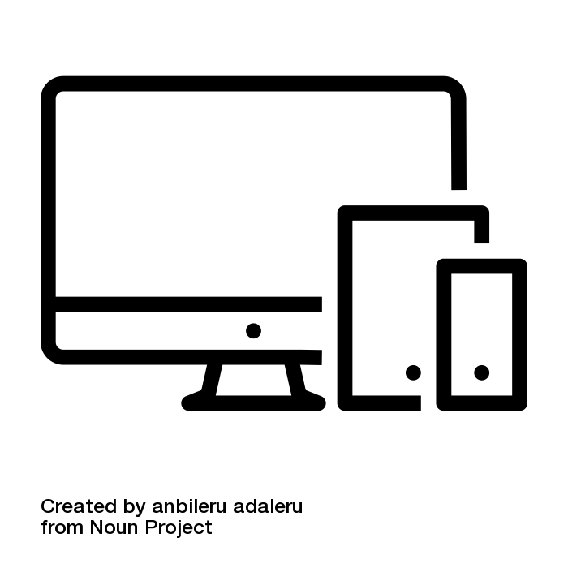
Mitigation strategy: Standardization + BYOD
BYOD (Bring your own device)
Support for a broad range of devices; check configuration ahead of time!
Wireless options available in some rooms
Notes:
PCs in the classroom for compatibility with peripherals
adapter rings (we suggest troubleshooting session ahead of time though!)

Slide 31
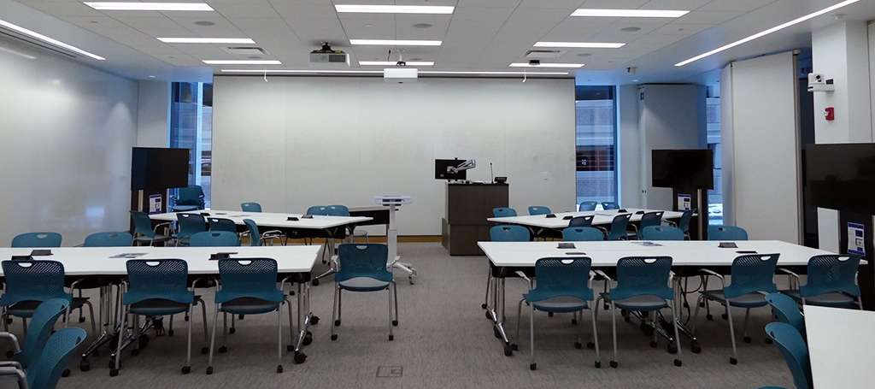
Wireless Collaboration for BYOD

Slide 32
Other Barriers: Two Blackboards
Problem
Two different Blackboard instances with different addresses with increasingly overlapping audiences
Different toolsets and different support paths
Confusion

Slide 33
Combining Blackboards
Context and Solution
Why do we have two LMS instances?
Benefits of combining
What does “Ultra” mean? Video intro: https://youtu.be/9nrP1Zlru2g
Roll out strategy and timeline
Beta/Pilot testing
Sandbox

Slide 34
Other Barriers: Lack of Accessibility
Problem
Online experience for community members with disabilities varies
Solution
Digital strategy group in ITS and ADA project
Ally: Multiple formats for content uploaded to Blackboard
ADA Project Website - in development

Slide 35
Other Barriers: Large University
Problem
Tools, knowledge, and other resources dispersed throughout the university
Resolution
Coordination

Slide 36
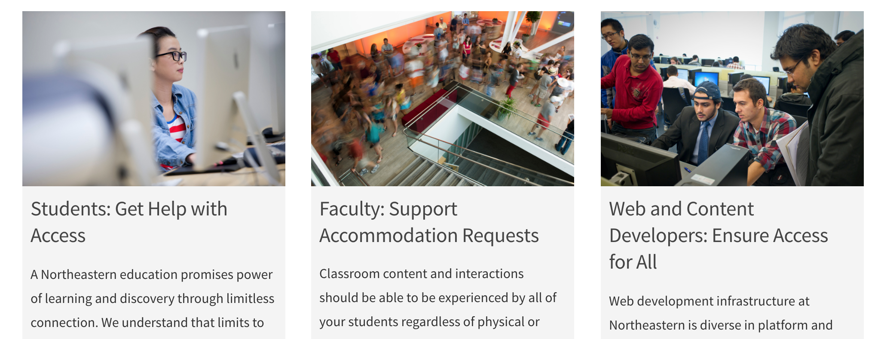
Digital Accessibility Website

Slide 37
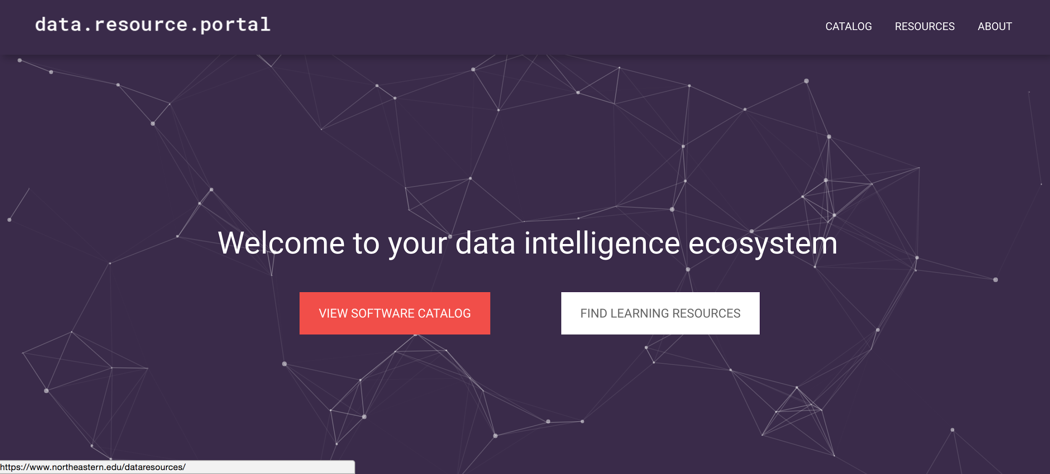
Aggregating Resources

Slide 38
Other Barriers: Human Cost of Updating
Problem
Replacing aging technology requires coordination (Blackboard Learn 9.1, Blackboard Collaborate Classic)
Solution
Communication and support to adapt to newer technologies
Update your browser and be supportive of vendors that leverage new technologies
Notes:
Barrier: new technology isn’t always compatible with old configurations: Keeping up with the modern: Collaborate Ultra or Playposit - uses modern browser technology. So choose Chrome or Firefox if you’d like to get the most features with easiest setup. But the flexibility comes with the fact that you can still use Blackboard Collaborate Classic now. Or even BlueJeans for fewer features (but recording is enabled!) Analog to digital in the classrooms...

Slide 39
Thank you!
Connect with us
ats@northeastern.edu
Snell Library 212 (inside SL 211)
617-396-4287

Slide 40
Academic Technology Services

