Slide 1
Lifelong Experiential Learning: SAIL
Michael Sweet, Ph.D.
Director of Design and Integration - CATLR

Slide 2
Activity
Think about someone from whom you’ve learned something positive related to one of the SAIL skills/attributes—not necessarily in the classroom.
Write down their name.
Notes:
Hand out b/w alphabetized lists.
Just skim this list and see if someone pops into your mind as associated with one of those characteristics.

Slide 3
Activity
Think about a specific experience with them from which you came away with something meaningful related to the skills/attributes.
Jot down a few words about it.
Notes:
You had some experience with them—at least one—that was impactful enough for them to pop into your head today. It can be hard to think about specifics, but try to identify one experience where they exemplified this trait that you’ve associated with them.

Slide 4
Activity
How did that moment help you, specifically, moving forward? What’s one time you put that learning to use, even if just to think differently?
Jot down some details.
Notes:
The experience you had with them was powerful enough for you to remember it and think of it today, so it likely has shaped something about how you do what you do. Is there at least one thing you’ve done where you think that person’s influence had a hand in how you did it?

Slide 5
Activity
Turn to your neighbor and share what you wrote.
Are there commonalities in your stories?
Interesting differences?
Notes:
Give them time to tell each other stories.
Then ask for examples: what’s the person’s name, what’s the skill or attribute, what’s the story?

Slide 6
Self-Authored Integrated Learning
EXPERIENTIAL LEARNING
Self-Authorship research describes three lines of development, in which we become increasingly sophisticated in our habits of mind:
Knowledge – increasing sophistication in how one evaluates information and claims about “the truth.”
Identity – increasing sophistication in how one understands one’s self and one’s values.
3. Relationships – increasing sophistication in how one engages and grows in relation to others.
Notes:
The self-authorship literature’s three lines of development, in which we become increasingly sophisticated as we accumulate experience over time.
Ask anyone who’s been out on co-op and they’ll tell you they grew a lot in these ways. That’s the power of experiential learning.
The stories you just told are about experiences you learned from—experiential learning moments that were extremely useful to you.

Slide 7
The Spirit of SAIL
Experiential learning is not just “out there.” We have experiences every day that can be experiential-learning moments if we think about them in the right way.
Developing “every day experiential learning” skills requires a unified learning ecosystem to support the learner across contexts and across time, to learn these skills and ingrain them as habits.
SAIL represents the shift from experiential learning “out there” to “every day” and the organizational changes to create this ecosystem of guidance and support.
Notes:
But we have historically thought about experiential learning as something that happens out there.
We can capture the experiential learning goodness of more of our experiences if we just develop the habits of thinking about them in the right way.
This is the spirit of SAIL—to support us in getting the most out of our experiences by helping cultivate habits of capturing the learning in those moments that can be useful to us later.
This isn’t something that can take place in a one-off way. We have to create an ecosystem that cues this thinking and cultivates these habits.

Slide 8
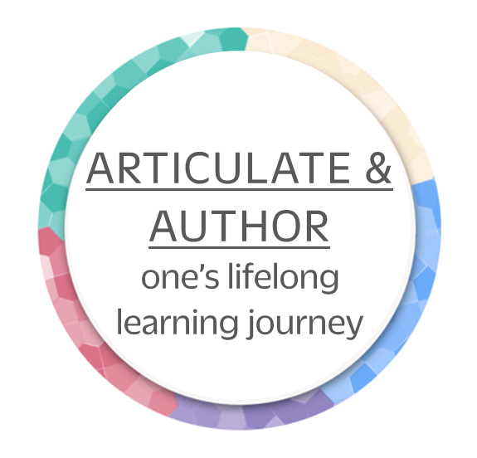
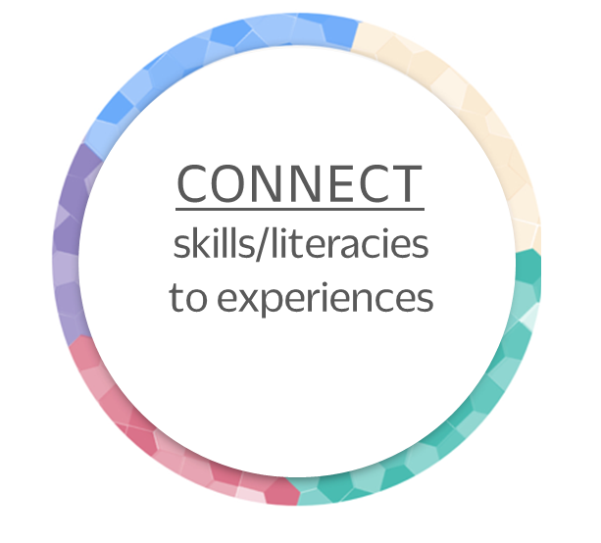
The Goals of SAIL
SAIL’s learning framework powers an ecosystem for HOLISTIC development where you learn to:
Notes:
In this world of constant change, SAIL’s goal is to help people become adaptable, lifelong learners,
who are able to grasp concepts deeply and then apply them to new, unfamiliar contexts.
S.

Slide 9
The Goals of SAIL
SAIL’s learning framework powers an ecosystem for HOLISTIC development where you learn to:
Notes:
In this world of constant change, SAIL’s goal is to help people become adaptable, lifelong learners,
who are able to grasp concepts deeply and then apply them to new, unfamiliar contexts.
S.

Slide 10
Highly valued skills and attitudes
Advocacy
Empathy
Networking
Networking
Aesthetic Appreciation
Aesthetic Appreciation
Entrepreneurship
Open-Mindedness
Boundary Setting
Ethical Reasoning
Organization
Civic-Mindedness
Financial Literacy
Perseverance/Resiliency
Coaching/Mentoring
Help Seeking
Planning
Collaboration/Teamwork
Humility
Problem Solving
Comfort with Ambiguity
Inclusivity/Inclusive Action
Quantitative Reasoning
Inclusivity/Inclusive Action
Communication
Independence/Autonomy
Resourcefulness
Computational Thinking
Information Literacy
Self-Care
Conflict Resolution/Transformation
Self-Control
Conflict Resolution/Transformation
Initiative
Creative Thinking/Innovation
Inquiry & Analysis
Self-Efficacy/Confidence
Critical Thinking
Integrative Thinking
Self-Directed Learning
Strategic Thinking
Cultural Agility
Integrity
Strategic Thinking
Systems Thinking
Systems Thinking
Decision-Making
Leadership
Systems Thinking
Time Management
Design Thinking
Mindfulness
Time Management
Notes:
These are the skills and attitudes that are important to leading a successful, gratifying life. We believe that, in addition to academic content, Northeastern should also play a role in helping you develop or improve these generalizable capabilities. But the list can be overwhelming!

Slide 11
Highly valued skills and attitudes
Help Seeking
Aesthetic Appreciation
Advocacy
Independence/Autonomy
Computational Thinking
Conflict Resolution/Transformation
Initiative
Design Thinking
Civic-Mindedness
Perseverance/Resiliency
Entrepreneurship
Inclusivity/Inclusive Action
Resourcefulness
Information Literacy
Networking
Self-Directed Learning
Integrative Thinking
Systems Thinking
Self-Efficacy/Confidence
Quantitative Reasoning
Comfort with Ambiguity
Strategic Thinking
Humility
Systems Thinking
Integrity
Coaching/Mentoring
Mindfulness
Aesthetic Appreciation
Conflict Resolution/Transformation
Open-Mindedness
Boundary Setting
Financial Literacy
Self-Care
Organization
Collaboration/Teamwork
Self-Control
Networking
Communication
Time Management
Planning
Empathy
Leadership
Strategic Thinking
Cultural Agility
Time Management
Creative Thinking/Innovation
Inclusivity/Inclusive Action
Critical Thinking
Systems Thinking
Decision-Making
Ethical Reasoning
Inquiry & Analysis
Problem Solving
Notes:
SAIL helps cluster and organize the laundry list of capabilities into categories that are more manageable and meaningful

Slide 12
Highly valued skills and attitudes
Help Seeking
Aesthetic Appreciation
Advocacy
Independence/Autonomy
Computational Thinking
Conflict Resolution/Transformation
Initiative
Design Thinking
Civic-Mindedness
Perseverance/Resiliency
Entrepreneurship
Inclusivity/Inclusive Action
Resourcefulness
Information Literacy
Networking
Self-Directed Learning
Integrative Thinking
Systems Thinking
Self-Efficacy/Confidence
Quantitative Reasoning
Comfort with Ambiguity
Strategic Thinking
Humility
Systems Thinking
Integrity
Coaching/Mentoring
Mindfulness
Aesthetic Appreciation
Conflict Resolution/Transformation
Open-Mindedness
Boundary Setting
Financial Literacy
Self-Care
Organization
Collaboration/Teamwork
Self-Control
Networking
Communication
Time Management
Planning
Empathy
Leadership
Strategic Thinking
Cultural Agility
Time Management
Creative Thinking/Innovation
Inclusivity/Inclusive Action
Critical Thinking
Systems Thinking
Decision-Making
Ethical Reasoning
Inquiry & Analysis
Problem Solving
Notes:
SAIL helps cluster and organize the laundry list of capabilities into categories that are more manageable and meaningful

Slide 13
The SAIL Framework
INTELLECTUAL AGILITY
GLOBAL MINDSET
Learners develop the ability to use knowledge, behaviors, skills, and experiences flexibly in new and unique situations to innovatively contribute to their field.
Learners develop knowledge, skills and behaviors to live, work and communicate with people whose background, experience and perspectives are different from their own as well as to consider the global impact of their decisions.
Aesthetic Appreciation
Computational Thinking
Design Thinking
Cultural Agility
Entrepreneurship
Inclusivity/Inclusive Action
Information Literacy
Systems Thinking
Integrative Thinking
Quantitative Reasoning
Strategic Thinking
Systems Thinking
Help Seeking
Independence/Autonomy
Initiative
Perseverance/Resiliency
Resourcefulness
Self-Directed Learning
Self-Efficacy/Confidence
Comfort with Ambiguity
Humility
Integrity
Mindfulness
Open-Mindedness
Collaboration/Teamwork
Communication
Empathy
Leadership
Creative Thinking/Innovation
Critical Thinking
Decision-Making
Ethical Reasoning
Inquiry & Analysis
Problem Solving
Advocacy
Conflict Resolution/Transformation
Civic-Mindedness
SOCIAL CONSCIOUSNESS & COMMITMENT
Inclusivity/Inclusive Action
Aesthetic Appreciation
Networking
Boundary Setting
WELL-BEING
Systems Thinking
Self-Care
Self-Control
Time Management
Learners develop knowledge, skills and behaviors necessary to live balanced and fulfilling lives.
Learners develop the confidence, skills and values to effectively recognize the needs of individuals, communities, and societies and make a commitment to constructively engage in social action.
Coaching/Mentoring
Conflict Resolution/Transformation
Financial Literacy
Organization
Networking
Planning
Strategic Thinking
Time Management
PROFESSIONAL & PERSONAL EFFECTIVENESS
Learners develop the confidence, skills, behaviors and values to effectively discern life goals, form relationships and shape their personal and professional identities to achieve fulfillment.
Notes:
We call these clusters “dimensions.” There is a lot to the dimensions, and details are included in SAIL orientation materials, but here is a brief overview..
Intellectual agility includes things like the ability to think critically. Global mindset is the ability to collaborate and communicate with people whose perspectives might be different from yours, and to think of the larger impact of your decisions. Social consciousness and commitment includes contributing to making the world around you a better place. Well being involves taking care of yourself. Professional and personal effectiveness includes skills that help you figure out a pathway for yourself and have good interpersonal relationships.
The SAIL framework includes other components, too, such as foundational skills that are important in every dimension of life, things like open-mindedness and empathy, and discipline-specific knowledge.

Slide 14
The SAIL Framework
FOUNDATIONAL MASTERIES
Intrapersonal Skills
Interpersonal Skills
Help Seeking
Collaboration/Teamwork
Independence/Autonomy
Communication
Initiative
Empathy
Perseverance/Resiliency
Leadership
Resourcefulness
Self-Directed Learning
Strategic Toolkit
Self-Efficacy/Confidence
Creative Thinking/Innovation
Critical Thinking
Attributes
Decision-Making
Comfort with Ambiguity
Ethical Reasoning
Humility
Inquiry & Analysis
Integrity
Problem Solving
Mindfulness
Open-Mindedness
Notes:
We call these clusters “dimensions.” There is a lot to the dimensions, and details are included in SAIL orientation materials, but here is a brief overview..
Intellectual agility includes things like the ability to think critically. Global mindset is the ability to collaborate and communicate with people whose perspectives might be different from yours, and to think of the larger impact of your decisions. Social consciousness and commitment includes contributing to making the world around you a better place. Well being involves taking care of yourself. Professional and personal effectiveness includes skills that help you figure out a pathway for yourself and have good interpersonal relationships.
The SAIL framework includes other components, too, such as foundational skills that are important in every dimension of life, things like open-mindedness and empathy, and discipline-specific knowledge.

Slide 15
Project
Internship
Meeting
Ball game
Film
Book
Team
Trip
NUpath
Class
Training
Workshop
Chat
Dialogue

Slide 16
Connect skills and literacies to experiences

Slide 17
Networking
Advocacy
Aesthetic Appreciation
Strategic Thinking
Strategic Thinking
Self-Care
Organization
Civic-Mindedness
Boundary Setting
Design Thinking
Conflict Resolution/
Transformation
Entrepreneurship
Negotiation
Cultural Agility
Systems Thinking
Advocacy
Cultural Agility
Inclusivity/
Inclusive Action
Strategic
Thinking
Aesthetic
Appreciation
Connect skills and literacies to experiences

Slide 18
Initiative
Networking
Initiative
Advocacy
Aesthetic Appreciation
Strategic Thinking
Strategic Thinking
Self-Care
Organization
Civic-Mindedness
Empathy
Boundary Setting
Initiative
Leadership
Design Thinking
Entrepreneurship
Conflict Resolution/
Transformation
Negotiation
Initiative
Cultural Agility
Systems Thinking
Advocacy
Cultural Agility
Integrity
Leadership
Inclusivity/
Inclusive Action
Strategic
Thinking
Aesthetic
Appreciation
Connect skills and literacies to experiences
Notes:
By explicitly calling out the skills and foundational masteries connected to these experiences,
learners can be more specific when reflecting about their past growth
and more intentional about seeking opportunities to develop skills that are in line with their goals.

Slide 19
Initiative
Networking
Initiative
Advocacy
Aesthetic Appreciation
Strategic Thinking
Strategic Thinking
Self-Care
Organization
Civic-Mindedness
Empathy
Boundary Setting
Initiative
Leadership
Design Thinking
Entrepreneurship
Conflict Resolution/
Transformation
Negotiation
Initiative
Cultural Agility
Systems Thinking
Advocacy
Cultural Agility
Integrity
Leadership
Inclusivity/
Inclusive Action
Strategic
Thinking
Aesthetic
Appreciation
Integrate learning across experiences
Notes:
The shared language of these dimensions and skills
facilitates a learner’s process of making connections between growth and learning from many different past experiences
that may not have otherwise been intuitively related.

Slide 20
Articulate & author one’s lifelong learning journey
Notes:
The self-awareness a learner gains by reflecting on their past experiences in an integrated and meaningful way
better enables them to articulate a coherent and targeted personal narrative to others,
whether that be peers, colleagues, or potential employers.
It also enables learners to more intentionally prepare for and seek out future opportunities that are in line with their values and goals. This self-directed creation of one’s journey, or self-authorship, is a well-researched theory within the student development literature, and is one of the diving forces behind SAIL.

Slide 21
How?
Embedding this type of thinking throughout the Northeastern Community
Reinforcing the idea that learning happens everywhere
Everyone on campus is both an educator and a learner

Slide 22
Learning Opportunities to SAIL (course)

Slide 23
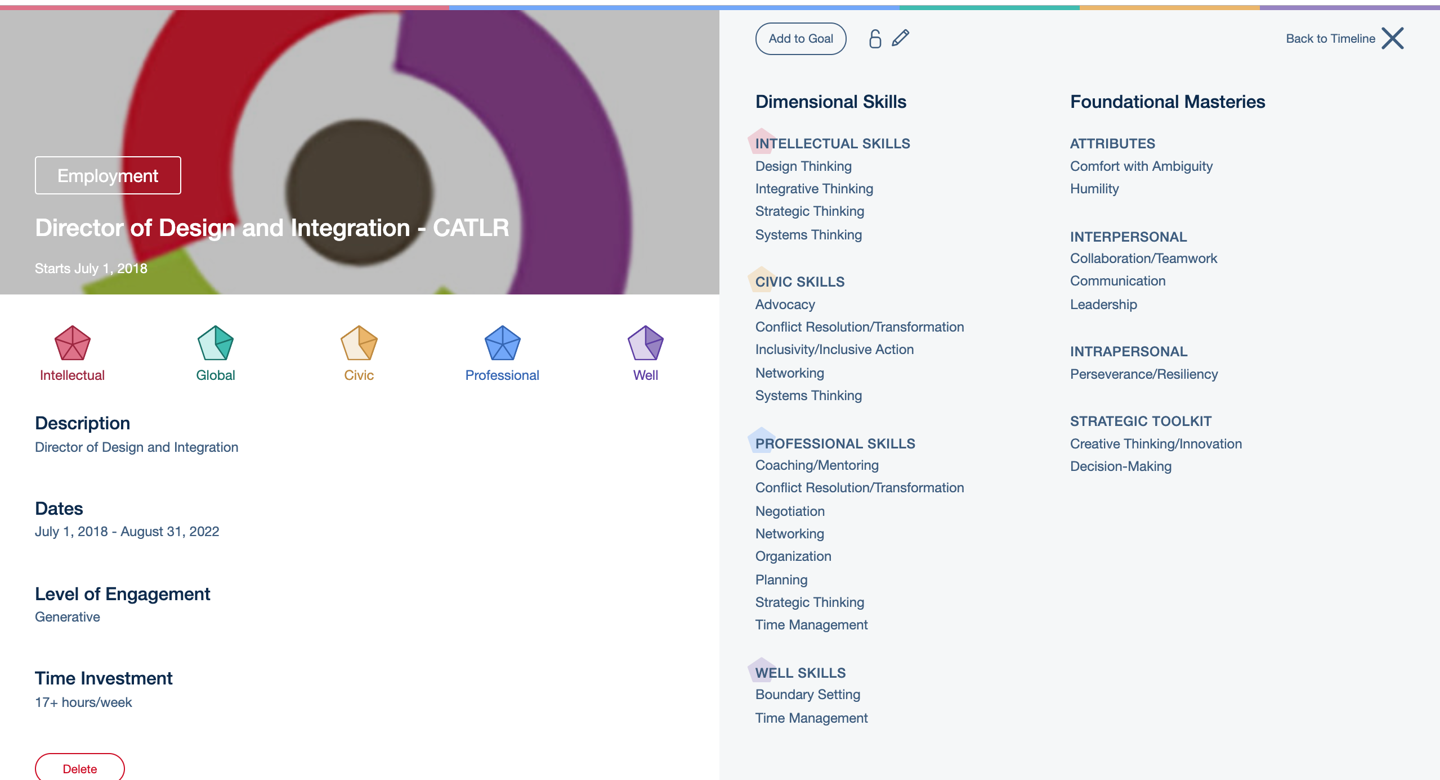
Learning Opportunities to SAIL (job)

Slide 24
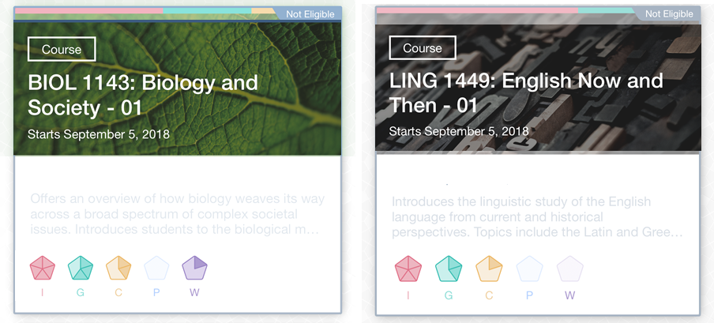
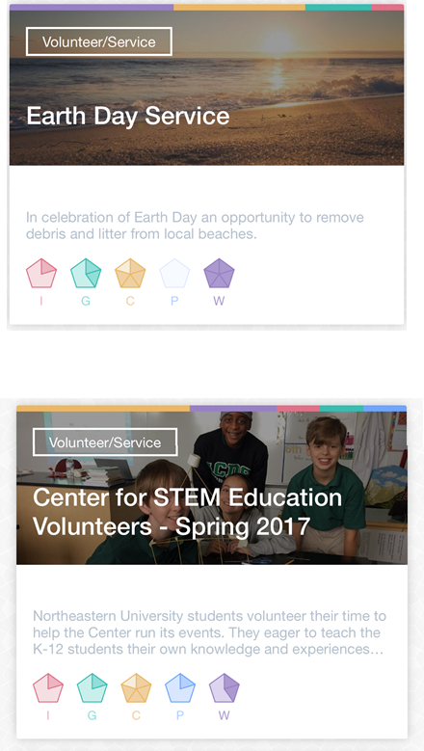
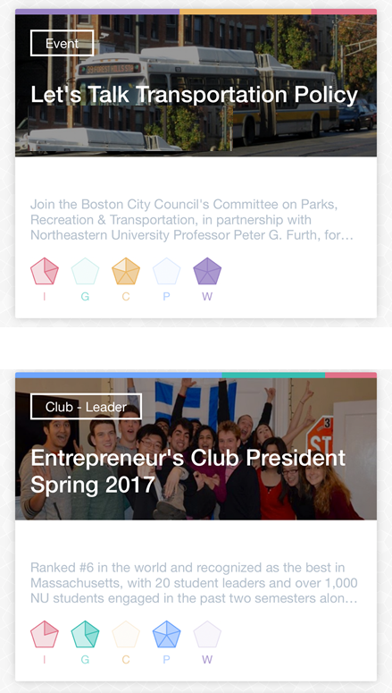
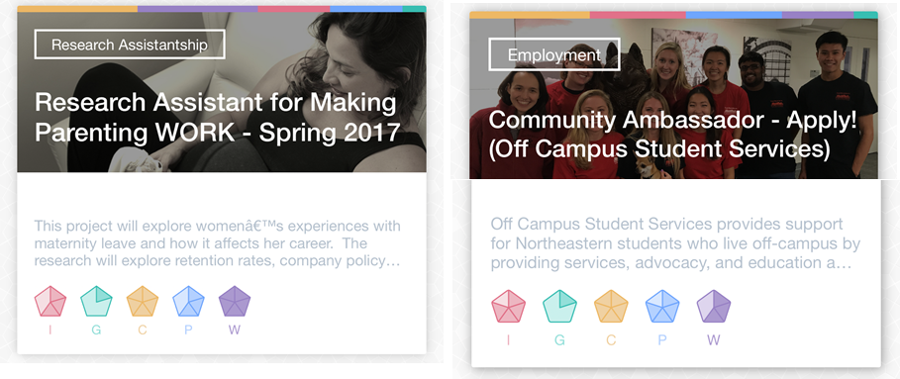
Learning Inside and Outside of the Classroom

Slide 25
SAIL Tools
integrate.sail.northeastern.edu
Notes:
Lead off with the story of how SAIL was received differently when we introduced folks to the language and framework in terms of their own experience first, as opposed to when we led with the app first. We learned a lot from the difference in these two receptions, especially that we have to make clear….

Slide 26
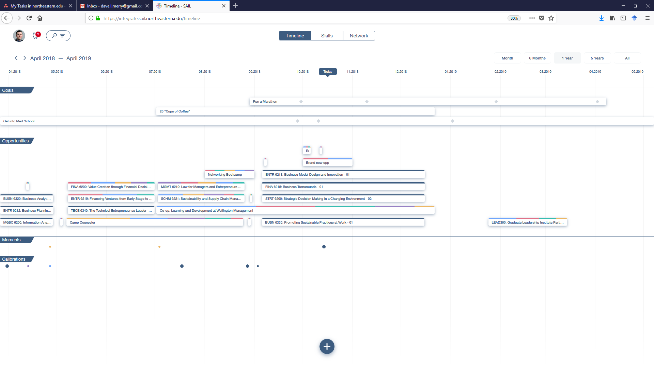

Slide 27
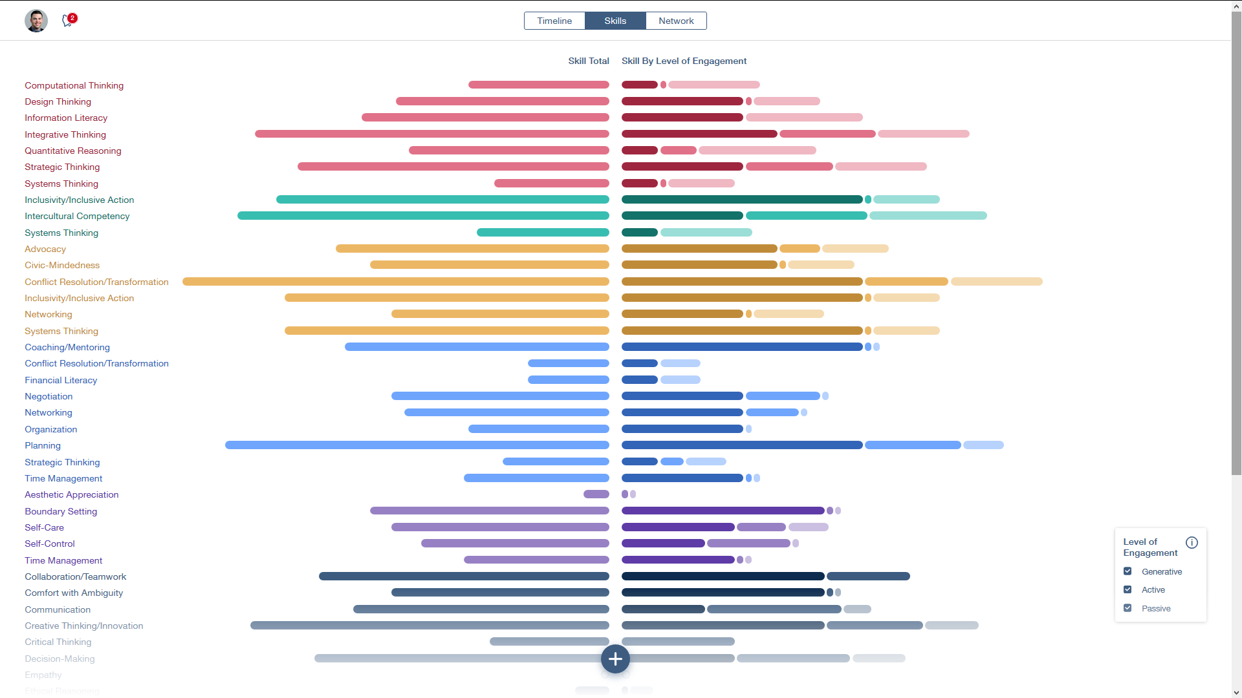

Slide 28
SAIL.northeastern.edu
Notes:
What is SAIL in a nutshell?
SAIL—Self-Authored Integrated Learning—is the latest advance in experiential learning at Northeastern. It’s an approach to learning that extracts meaning, not just from courses, co-op or study abroad, but also from everyday experience.
USE for Video C: SAIL provides a common framework and vocabulary for talking about learning along five broad dimensions of personal and professional growth and leadership. Within each dimension, SAIL helps learners master skills and traits, from critical thinking to empathy.

