Slide 1
Ccis Grad Co-op Academic Technologies
Thursday, May 3, 2018
Presented by:
Francisco (Paco) Mesch, graduate co-op Coordinator, co-op faculty
Notes:
Hi! I’m Paco Mesch representing the College of Computer and Information Science’s Grad Co-op Team. Today I’ll be talking about the Academic Technologies our department uses inside as well as outside the classroom. I will briefly touch on the technologies first used when I started at Northeastern in 2015, and then I will go over the technologies my department has picked up in the past 3 years in working with ATS.

Slide 2
Resources CCIS Was using
Notes:
When I first started, Piazza was used to house documents and host student discussions. To be perfectly honest, I can’t really speak much about Piazza as I never really used it.

Slide 3
Resources CCIS Was using
Notes:
We also used Google Drive for surveys, some student progress tracking and several presentations.

Slide 4
Resources CCIS Was using
Notes:
We also utilized Blackboard for our co-op seminar. Full disclosure, in Seattle, we really only posted the syllabus for reference on Blackboard and that was the extent of it. The syllabus contained the course schedule as well as assignments. Between 2015 and 2018 however, we picked up quite a few more tools… but I am getting ahead of myself.

Slide 5
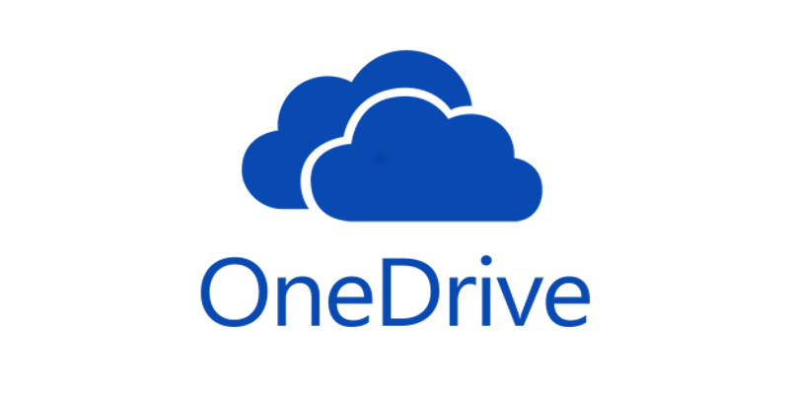
Fall 2015 Changes
Co-op Seminar revamp
OneDrive access
First use of Storyline
Notes:
In Fall 2015, there were a few changes that pushed us (and by us I speak mostly about NU-Seattle) to revamp the Co-op Seminar. Around this time, OneDrive began making the rounds as a tool we could use to improve productivity. Boston also used Storyline to create an interactive resume training module.
As you might have noticed, all of this is still actually used within the classroom for our co-op seminar lessons. Bear with me. I’m just telling the story of how we went from minimal tech tool use to a plethora of options.

Slide 6
Fast forward to spring 2018
CCIS Grad Co-op now uses
Notes:
Fast forward to the present, and this slide showcases the various technologies Grad Co-op now uses:
Blackboard
Storyline
Office 365 and its most recognizable components: outlook/exchange, Word, Excel, PowerPoint, Skype, OneDrive and Sharepoint
And Adobe of course because really, we still do need physical documentation for a few things.

Slide 7
Blackboard
Uses and Advantages in the classroom
Class management
Attendance
Assignments
Exams
Grading
Course Copy
Discussions
Notes:
Let’s start with Blackboard. Its uses and advantages in the classroom are plenty:
Overall class management
Attendance tracking
Assignments
Tests and exams
Grading
The ability to copy a previous course and use its assets for another (wholesale or piecemeal)
And of course we have student interactions as well like class topic discussions.

Slide 8
Blackboard
Uses and Advantages outside the classroom
CCIS Work Experience Policies and Resources Database
Student progress in Co-op Requirements
Policies and Resource Database
Child Courses
Easy customization
Student access from virtually anywhere
Notes:
Now let’s look at a broader, outside the classroom use of Blackboard…
Utilizing the Community component of Blackboard, CCIS Grad Co-op created the Work Experience Policies and Resource Database to give our students a one-stop shop for anything and everything they might need before, during and after a co-op.
Students are added to this community component (as opposed to the Courses component) so that they have access to the information and resources within as soon as they have completed our co-op seminar. Because this is not a course, once students are given access, they may retain this throughout their time at Northeastern.
Student progress can be tracked for requirements we set for them like Kick-Off modules (modules they review in anticipation of going out on co-op)
Policies and resources are available to students 24/7, for example they can download the “co-op/internship acceptance agreement” document when needed or can review CCIS’ “taking a course while on co-op” policy.
A quick note on Child courses and its benefits. Child courses are sub sections for every upcoming batch of students looking to go on co-op. These subsections are created under the CCIS Work Experience Policies and Resources Database so we don’t’ have to copy the course, we simply add a new child course or subsection for any new batch of students.
Because this is Blackboard, this database is easy to customize, and any changes to the parent site rolls out to all subsections.
Lastly, students may access the database from virtually anywhere. Plus, we can refer students to this site for about 95% of their inquiries!

Slide 9
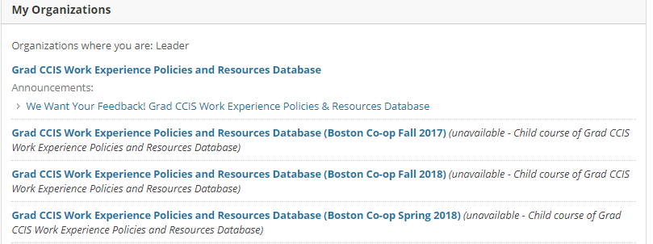
Community
Notes:
This is a screen capture of what shows up when accessing the Community Component of Blackboard. Students immediately see the database.

Slide 10
Database Sections
Notes:
And here we have a brief look at the quick-access menu found on the left-hand side of the Work Experience Policies and Database. This menu is organized logically following the before, during and after co-op framework in presenting information.

Slide 11
Storyline
Uses and Advantages
Interactive presentations
Ability to record instructor voice and video
Branching paths
Survey and assessment tools
Plugs into BlackBoard easily
With ability to monitor student progress
Easily copied from course to course
Notes:
One of the most useful tools ATS has shared with us is Storyline. I think of it as a significantly enhanced version of PowerPoint.
It has all the tools PowerPoint has to offer and then some. It allows for interactive presentations including the ability to record audio (and video) as well as branching paths in the presentation. It has survey and assessment tools which, by the way, easily plug into Blackboard. And in connecting with Blackboard, it gives the ability to monitor student progress. Furthermore, once a Storyline presentation has been created, it is really easy to copy it from course to course. I’m really only touching on the aspects I’ve used the most, and to be honest, I’ve probably only skimmed the surface at this point.

Slide 12
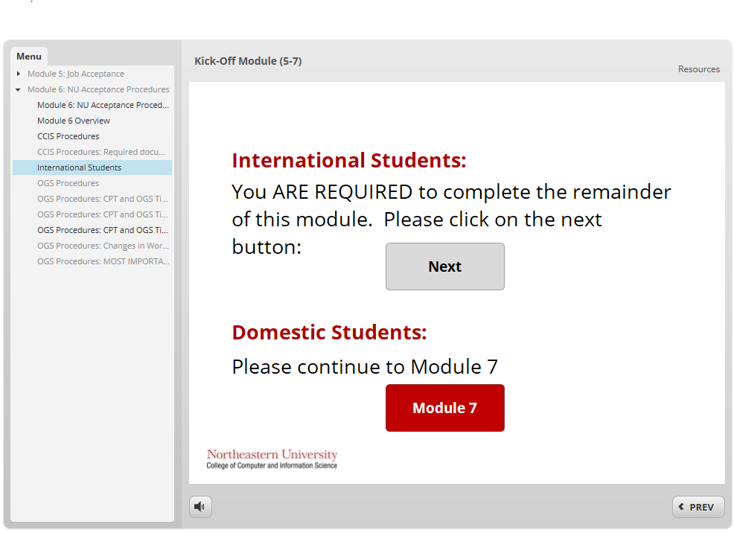
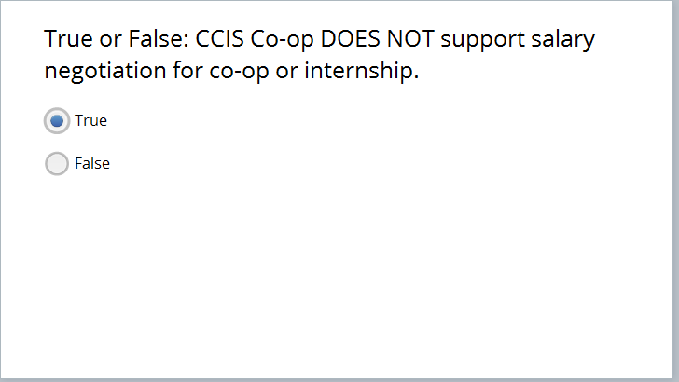
Kick-off modules
Notes:
One of the most in-depth uses CCIS Grad Co-op has of Storyline was in the development of our Kick-off modules
These modules used to be presented in PowerPoint; students had a post co-op seminar 1.5 hour meeting with us; eventually we made the modules into PDFs for students to review on their own then fill out a physical form acknowledging completing the modules.
Moving it to Storyline allowed us to remove the paperwork, present and test their comprehension (we inserted quizzes between modules) and had them complete a survey at the end to demonstrate understanding.

Slide 13
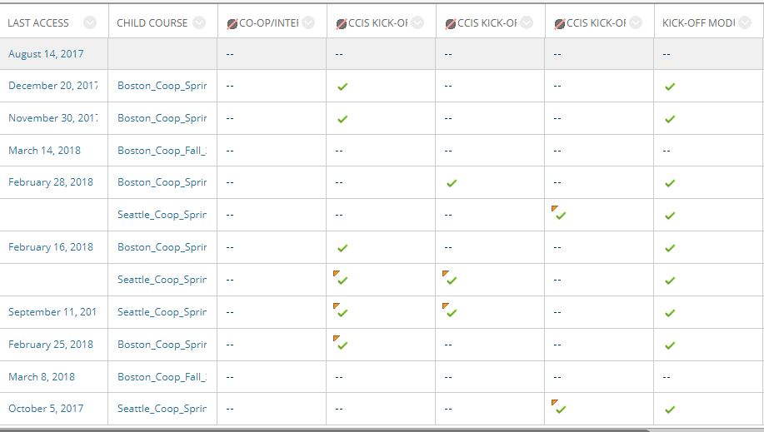
Student progress and Child courses
Notes:
Through Storyline’s integration with Blackboard, we can track completion of kick-off modules through the gradebook. Here you can see the sub sections for Seattle and Boston, and the check-marks designate which students have completed the kick-off modules.

Slide 14
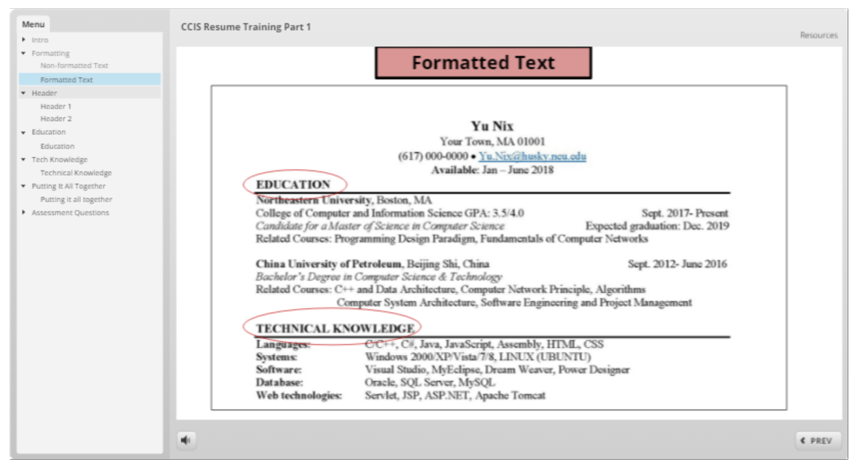
More Storyline Applications
Notes:
Our first use of storyline was to create a resume training module for the co-op seminar back in 2015. This is a snippet of an updated version from 2017. I actually recreated the entire module to better acquaint myself with storyline. And I have to say, I actually had fun doing this!

Slide 15
Microsoft Office 365
Uses and Advantages
Distance collaboration
Easy Communication
Multiple users in real time
File sharing
Online access from virtually anywhere
Shared data and tracking
Notes:
Office 365, I mean what else can I say? It’s Office, so really most of us already use it right? What I’ll do here instead is focus on ways we’ve used it to enhance productivity.

Slide 16
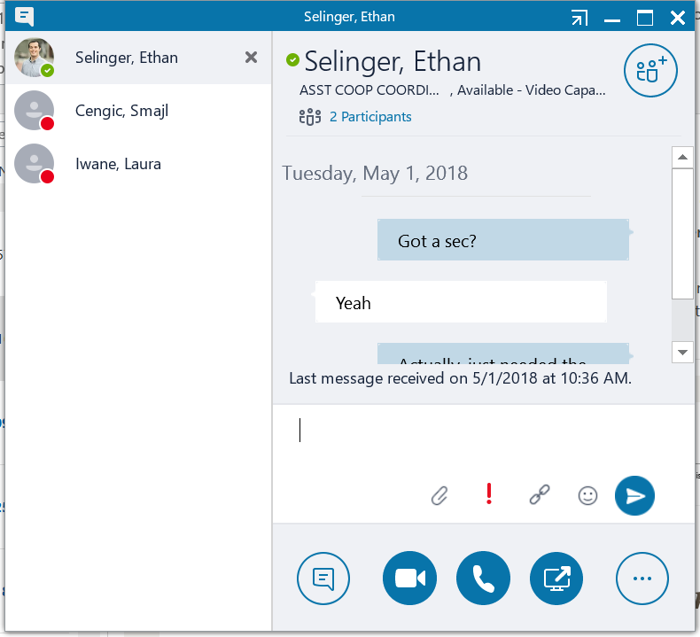
Communication
Notes:
We use Skype for business for quick questions as this capture demonstrates… and to be honest, I staged this specific exchange for THIS presentation. We also use Skype for videoconferencing by the way.

Slide 17
Multiple users through office 365
Distance collaboration
“Insert screenshot here”
Notes:
A couple weeks ago, Ethan Selinger and I presented at the (Cooperative Education and Internship Association) CEIA conference.
By the way Ethan sends his regards. He and I were originally going to jointly present at Texpo today, but CCIS has its commencement in Boston today. Ethan sends his regards though.
At any rate, Ethan and I would work on our presentation at the same time (click for circle) while discussing edits over Skype conferencing. This example is actually from a couple days ago when he was helping me edit this presentation!

Slide 18
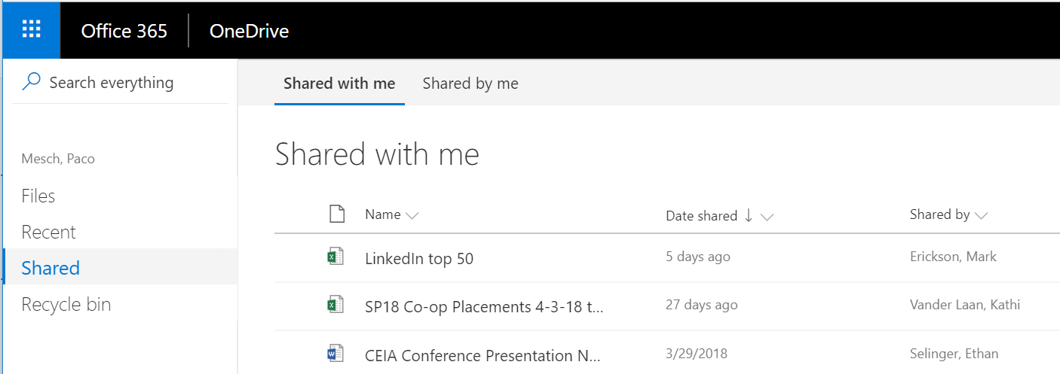
File sharing
Notes:
To facilitate file sharing as you saw in the previous slide, we use OneDrive to share access to the files. Here you can see the Word document (CLICK) Ethan and I worked on for the CEIA conference.

Slide 19
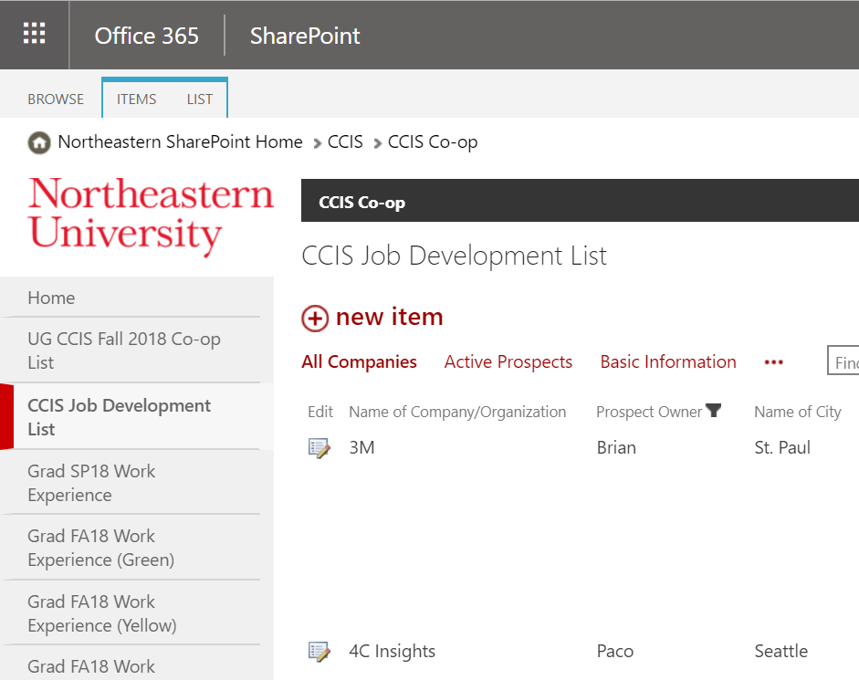
Shared database and tracking
Notes:
The last tool we utilize from Office 365 is probably one of the most accessed by all of us including the Undergrad Co-op Team: SharePoint. We use lists to track various data, most notably student placement in co-ops and employer outreach.

Slide 20
Adobe acrobat pro
Notes:
For the time we still need physical documentation, Adobe hits those needs.

Slide 21
CCIS grad co-op tech tools
CCIS Grad Co-op now uses
Notes:
We use the following technologies in the classroom as well as outside. I’ve been trained remotely by ATS, so they make learning any of these tools EASY!

Slide 22
Questions?

