Slide 2
Open Educational Resources (OERs)
“Open” = Openly licensed
Public domain or copyright holder has waived some rights (e.g., Creative Commons License)
Do not need permission to:
Use, Distribute, Modify/Remix
Free or cheap, i.e. cost of print production
OERs=Textbooks and
Images, video, audio
Open access journal content or e-books…
Chapters, other modular content
Affordable course materials=
OERs + utilize subscribed content

Slide 3
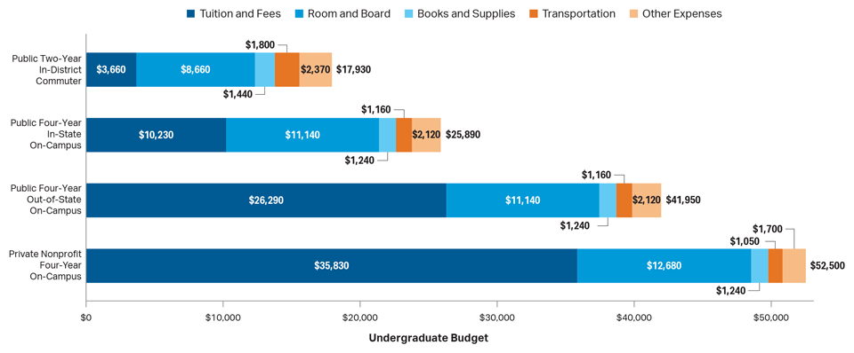
Average Estimated Full-Time Undergraduate Budgets, 2018-19 *SOURCE: College Board, Annual Survey of Colleges

Slide 4
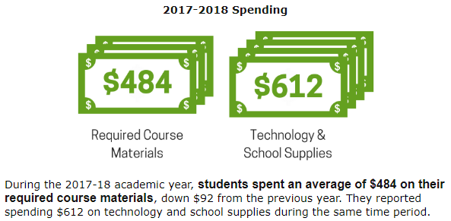
What the bookstores report *Source: National Association of College Stores

Slide 5
The textbook marketplace
Textbook prices increased 82% between 2002 and 2012
*Source: U.S. Government Accountability Office
Textbook prices increased 88% between 2006 and 2016
* Source: Bureau of Labor Statistics

Slide 6
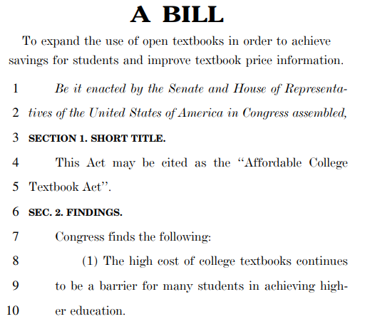
Affordable College Textbook Act

Slide 7
Research on outcomes and assessment
Fischer, L., Hilton, J., Robinson, T. & Wiley, D. (2015). A multi-institutional study of the impact of
open textbook adoption on the learning outcomes of post-secondary students. Journal of
Computing in Higher Education. 27: 159-. doi:10.1007/s12528-015-9101-x
Studied nearly 5000 students using OER with a control group of over 11,000 students. Students
using OER enrolled in a significantly higher number of credits in the following semester. Almost no
significant differences in completion rates. Course grades were mixed.
Wiley, D., Williams, L., DeMarte, D., & Hilton, J. (2016). The Tidewater Z-Degree and the INTRO model for sustaining OER adoption. Education Policy Analysis Archives, 23(41).
Studied Tidewater Community College (Virginia) Z-Degree in Fall 2013: Compared drop rates, withdrawal rates, and final grades. Course throughput rate improved with the Z degree program that uses OER in place of commercial textbooks over students in the non-Z degree classes.
Showed that drop rates are fewer with OER.

Slide 8
How students manage cost of textbooks
85% seek a free copy online [+21%]
52% delay purchase [+23%]
40% share [+2%]
39% do not purchase [+15%]
35% use older editions [-4%]
8% choose courses based on the cost [-2%]

Slide 9
Case study: Biology
2018, Summer Term 1: BIOL 1111 replaces $90 textbook with $0 open textbook
$2,700 savings (30 students)
88% said the textbook was the same or higher in quality

Slide 10
Case study: Biology
2018, Fall semester: BIOL 1111, BIOL 1113, BIOL 1115 replace $90 textbook with $0 open textbook
$36,970 savings (411 students)
$39,670 in savings

Slide 11
Getting started: finding and evaluating OERs

Slide 13
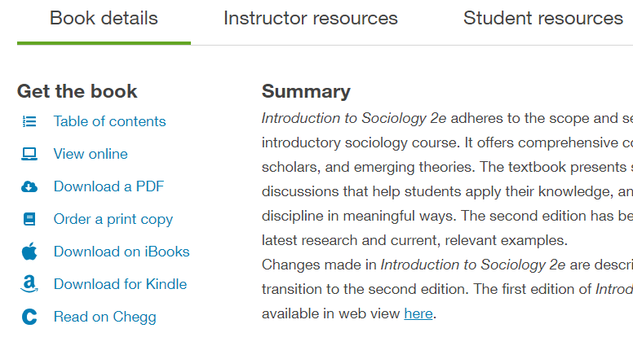

Slide 14
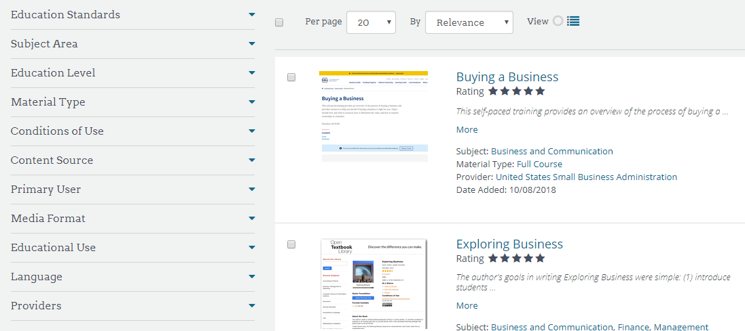

Slide 15
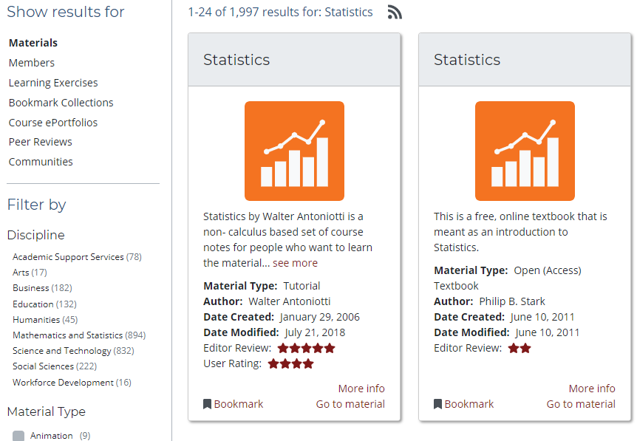

Slide 16
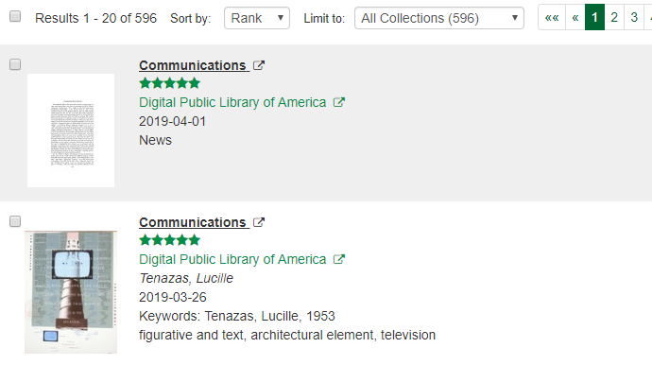
George Mason University Metafinder

Slide 17
Affordable Course Materials guide for faculty
https://subjectguides.lib.neu.e/du/affordablecoursematerials/faculty
Connect with textbook and other OER repositories
Contact:
Evan Simpson, Associate Dean for Research and Learning e.simpson@northeastern.edu, x4920

Slide 18
Future considerations
Collaboration: identifying expertise on campus; knowing more about what services/support different organizations on campus provide; develop
centralized support portal?
OER models: identify modes and models for creating OERs
from textbook replacement to student-created OERs, and everything in between
Funding: incentivizing adoption or creation of OERs; expanding licenses/adding subscriptions
Platforms: explore and invest in platforms that help instructors integrate content in new ways; that catalyze deeper student engagement with course resources…

