Slide 1
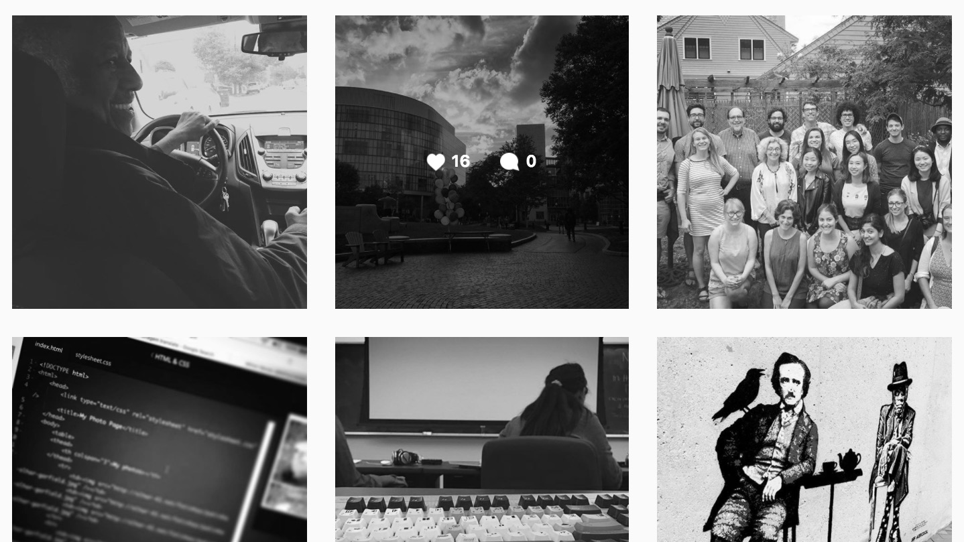
MIRCOLEARNING WITH SOCIAL MEDIA:
Learning in Burst
Stephanie Trowbridge . Clair Waterbury . Lindsey Sudbury

Slide 2
Notes:
When's the last time you learned something from Social Media?
https://www.polleverywhere.com/multiple_choice_polls/hBFD2cUoovuhx28

Slide 3
BACKGROUND
2014-2016
2016-2017
2017-2018
Notes:
For the past two years, ATS with S.I.T.E students have been researching mircolearning. Mention publication and case study research starting this fall (planning now).

Slide 4
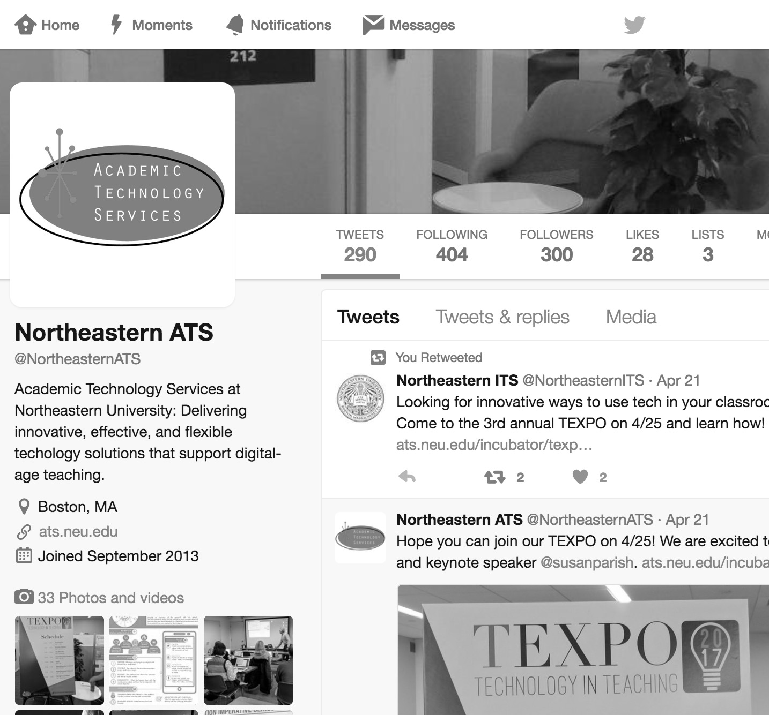
WHAT IS MICROLEARNING WITH SOCIAL MEDIA?
short, focused, bursts of learning that take place frequently in a digital social environment and is connected to a more expansive learning goal

Slide 5
Notes:
Are you using Social Media for teaching and learning? If so, please share how you are using it.
https://www.polleverywhere.com/free_text_polls/8ULpftTily50AAi

Slide 6
BENEFITS OF MICROLEARNING
Notes:
For the past two years, ATS with S.I.T.E students have been researching mircolearning.

Slide 7
MICROLEARNING STEPS
1
2
3
4
PURPOSE
CONTENT
DELIVERY
INTEGRATION
The subject of the microlearning object - a very small unit, or topic.
What the learner does with the microlearning object and how that is integrated with course objective.
What you are trying to accomplish with the activity or assignment.
The platform that allows the instructor and learner to post content.
Notes:
For the past two years, ATS with S.I.T.E students have been researching mircolearning.

Slide 8
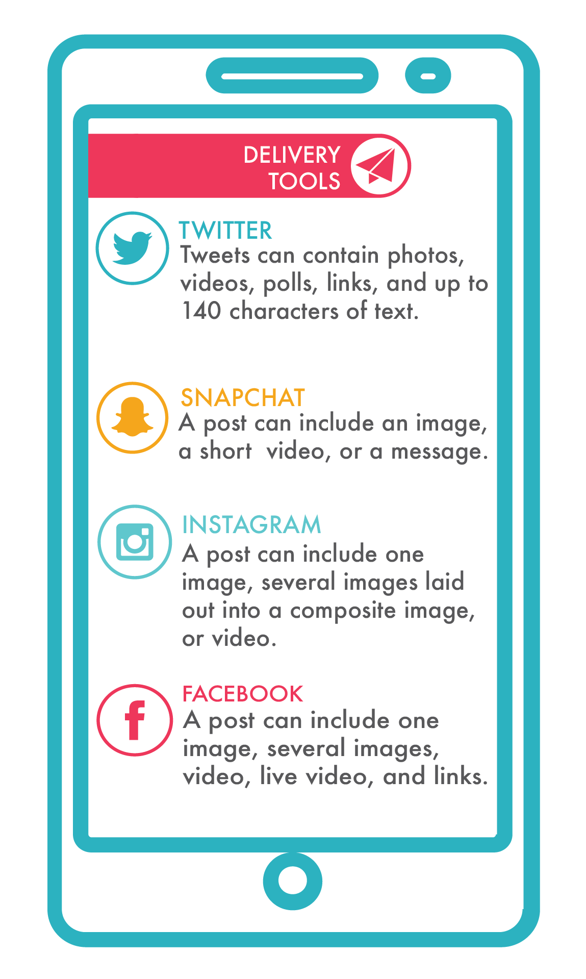
DELIVERY TOOLS
Delivery refers to the platforms that allow you to post content to your students and them to post created content back to you and/or the class.

Slide 9
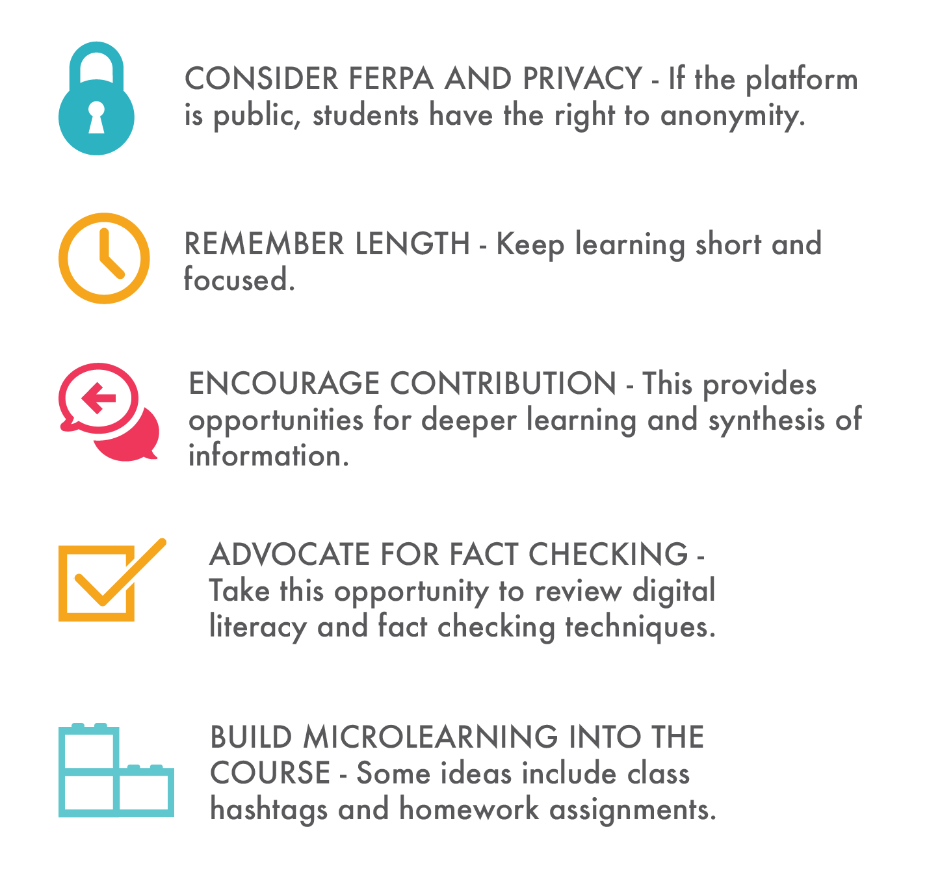
RECOMMENDED PRACTICES
When thinking about using Social Media as a delivery platform for Microlearning we recommend considering the following elements:

Slide 10
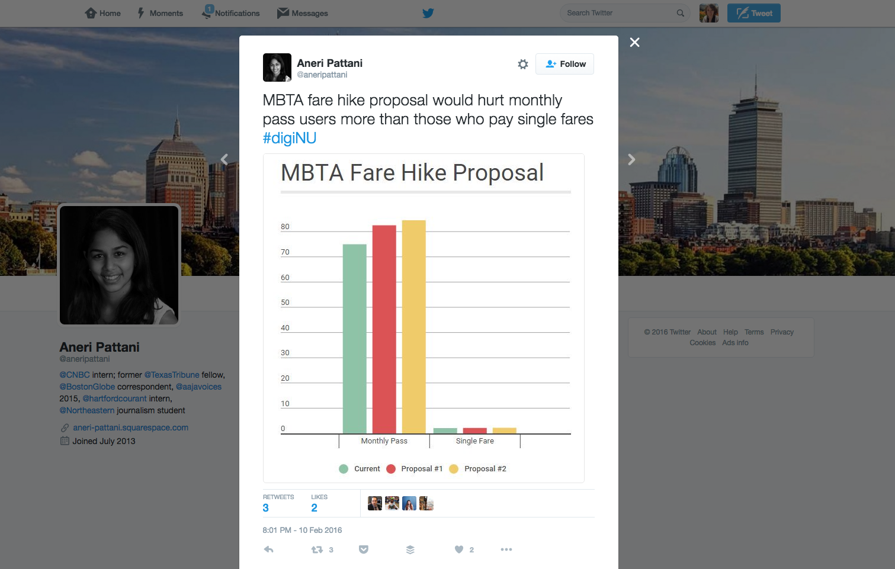
EXAMPLES: PROFESSOR JOHN WIHBEY Journalism
Students create a social graphic
#digiNU
Instagram – profiles
Reading snippets on twitter

Slide 11
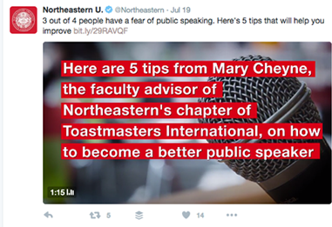
EXAMPLE: NORTHEASTERN U.
SnapChat takeovers
Twitter quick tips
Twitter community connections
Sharing work, news and research from Northeastern

Slide 12
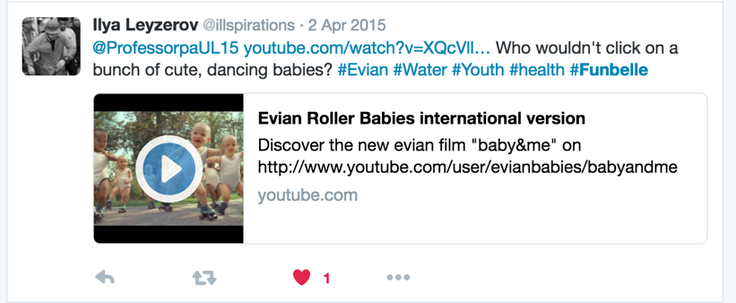
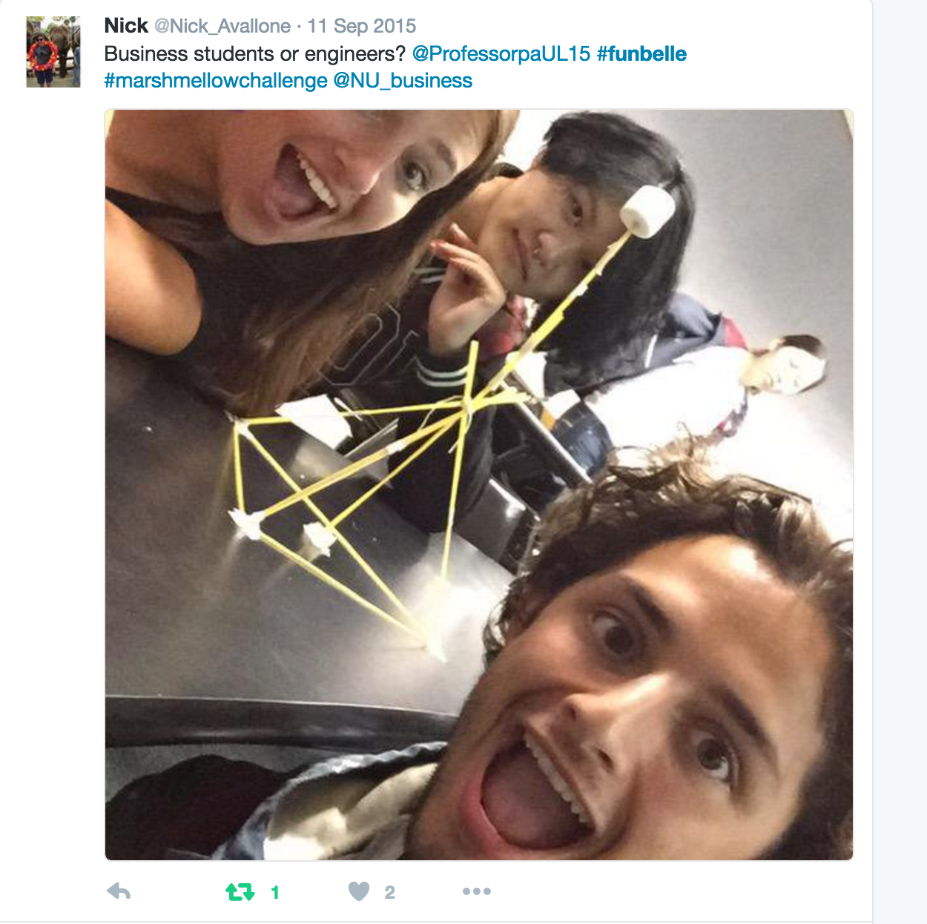
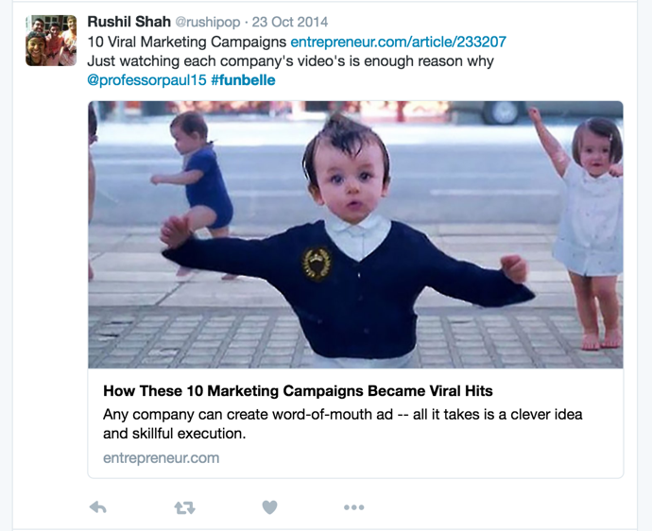
EXAMPLES: PROFESSOR PAUL FOMBELLE Marketing
Course hashtag #funbelle
Uses Facebook, Instagram, and Twitter
Uses social media for microlearning formally and informally

Slide 13
NEXT STEPS
If you would like to participate in the case study or gathering data, please email ats@northeastern.edu or submit your name here:
https://goo.gl/dfr6eD
CASE STUDY AND DATA GATHERING
2017-2018

Slide 14
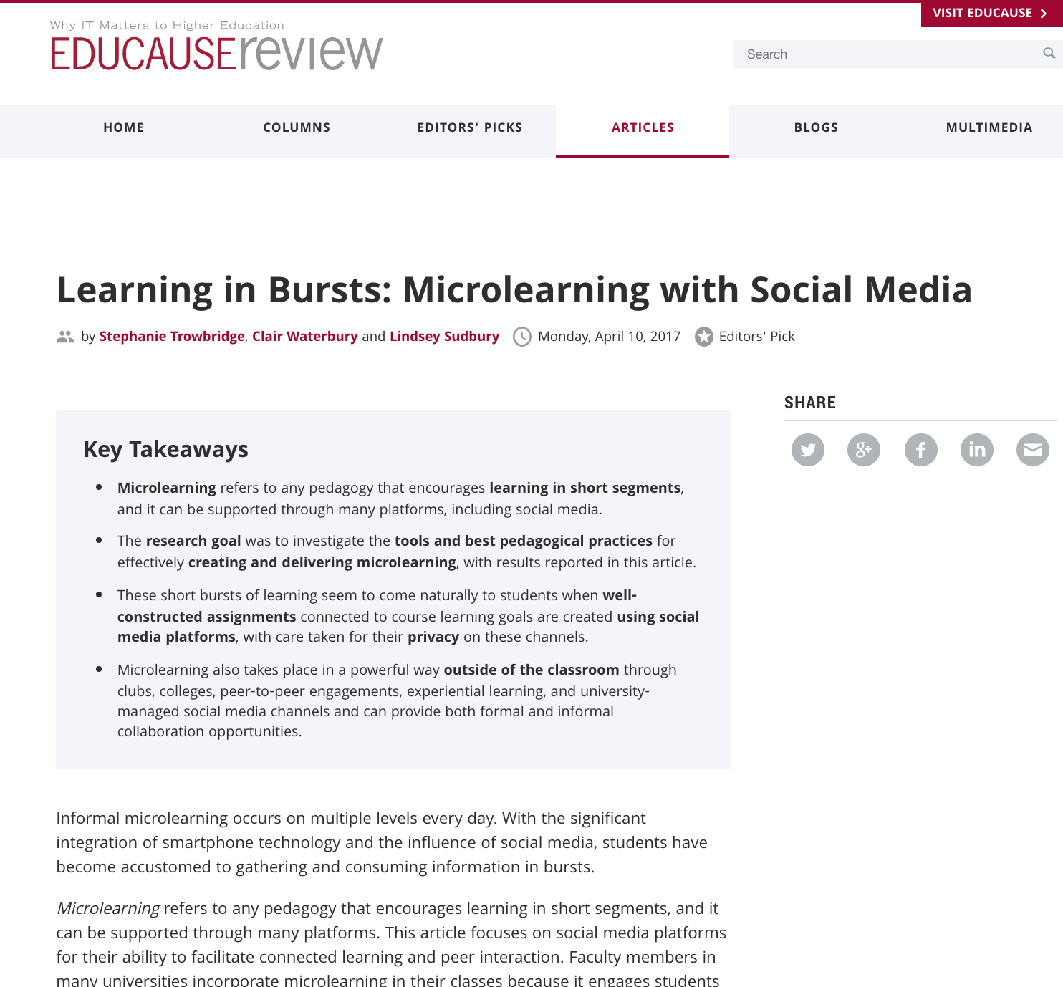
LEARN MORE
Read the microlearning article at:
https://goo.gl/8Wjk9E

Slide 15
THANK YOU!

