Slide 1

Using Learning Analytics to Inform Online Course Design & Delivery
Susan Gracia, PhD
Graduate School of Education
College of Professional Studies

Slide 2
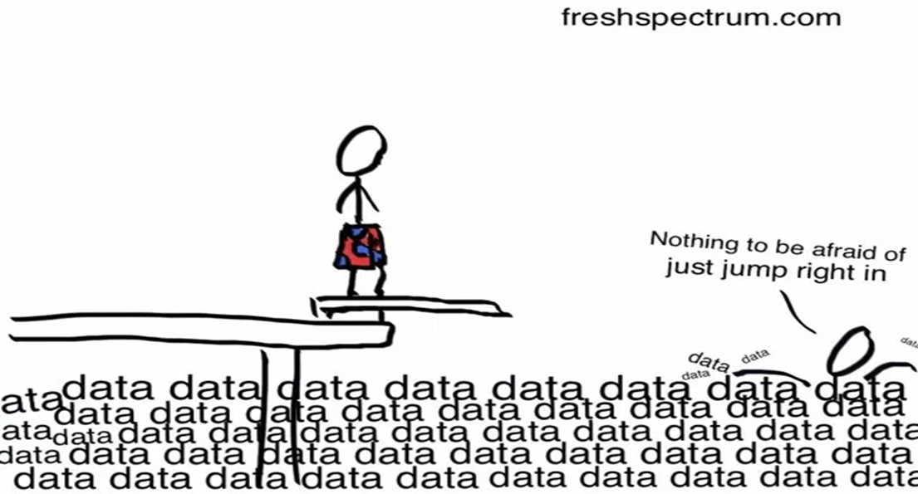
Online Educators: Swimming in a Sea of Data

Slide 3

Learning Analytics
Is “the measurement, collection, anlysis, and reporting of daa about learners and their contexts, for the purposeof understanding and optimizing learning and the environment in which it occurs” (Siemens, 2011)
Consists of collecting the traces that students leave behind and using these traces to improve learning (Duval, 2012)
Notes:
Una respuesta a este desafío se llama la Analítica del Aprendizaje (Learning Analytics) en ingles. Se define por Ferguson como….
Tambien me gusta esta segunda definición de Duval por el sentido de seguir los rastros de los alumnos

Slide 4
Learning Analytics (LA) & Learning Design (LD)
Learning Design (LD) describes an educational process and involves the design of units of learning, learning activities or learning environment which are pedagogically informed.
LA can provide the necessary data, methodologies and tools to test the assumptions of the learning design and how learning design choices influence learning and performance over time
Applying LA to LD can:
  Contribute to and augment existing good practices by improving them with insights and technical affordances
  Avoiding the oversimplification of learning enhancement to a data-driven, algorithmic process (Shibani, Knight, & Shum, 2019)

Slide 5
LD Questions Addressed by LA
How do we know that our learning design is effective?
Are students using/accessing resources as we had planned/expected? Which ones do they use most? Which do they not use?
Is greater use of resources associated with increased student learning or success?
Which students need further support and attention from instructors?
What online learning activity patterns predict student success on assignments and/or in the course?
How is knowledge is being co-constructed among learners?
Are the communication networks formed as part of the class effectively supporting processes known to contribute to successful learning, such as information sharing, community building, and collaboration?
Which students are likely to be good candidates for peer support learner leaders? Which students are more likely to be successful in working together on projects?

Slide 6
Using LA on Blackboard Course Data
EDC Learning Analytics Tool (Armitas, Tse & Chan, 2019, Educational Development Centre, The Hong Kong Polytechnic University)
  custom-designed tool to analyze Bb usage logs
  Excel tool supported by VBA code and Excel add-ins
Netlytic (netlytic.org)
  a cloud-based text and social networks analyzer that can automatically summarize and discover communication networks from publicly available social media posts or your own data

Slide 7
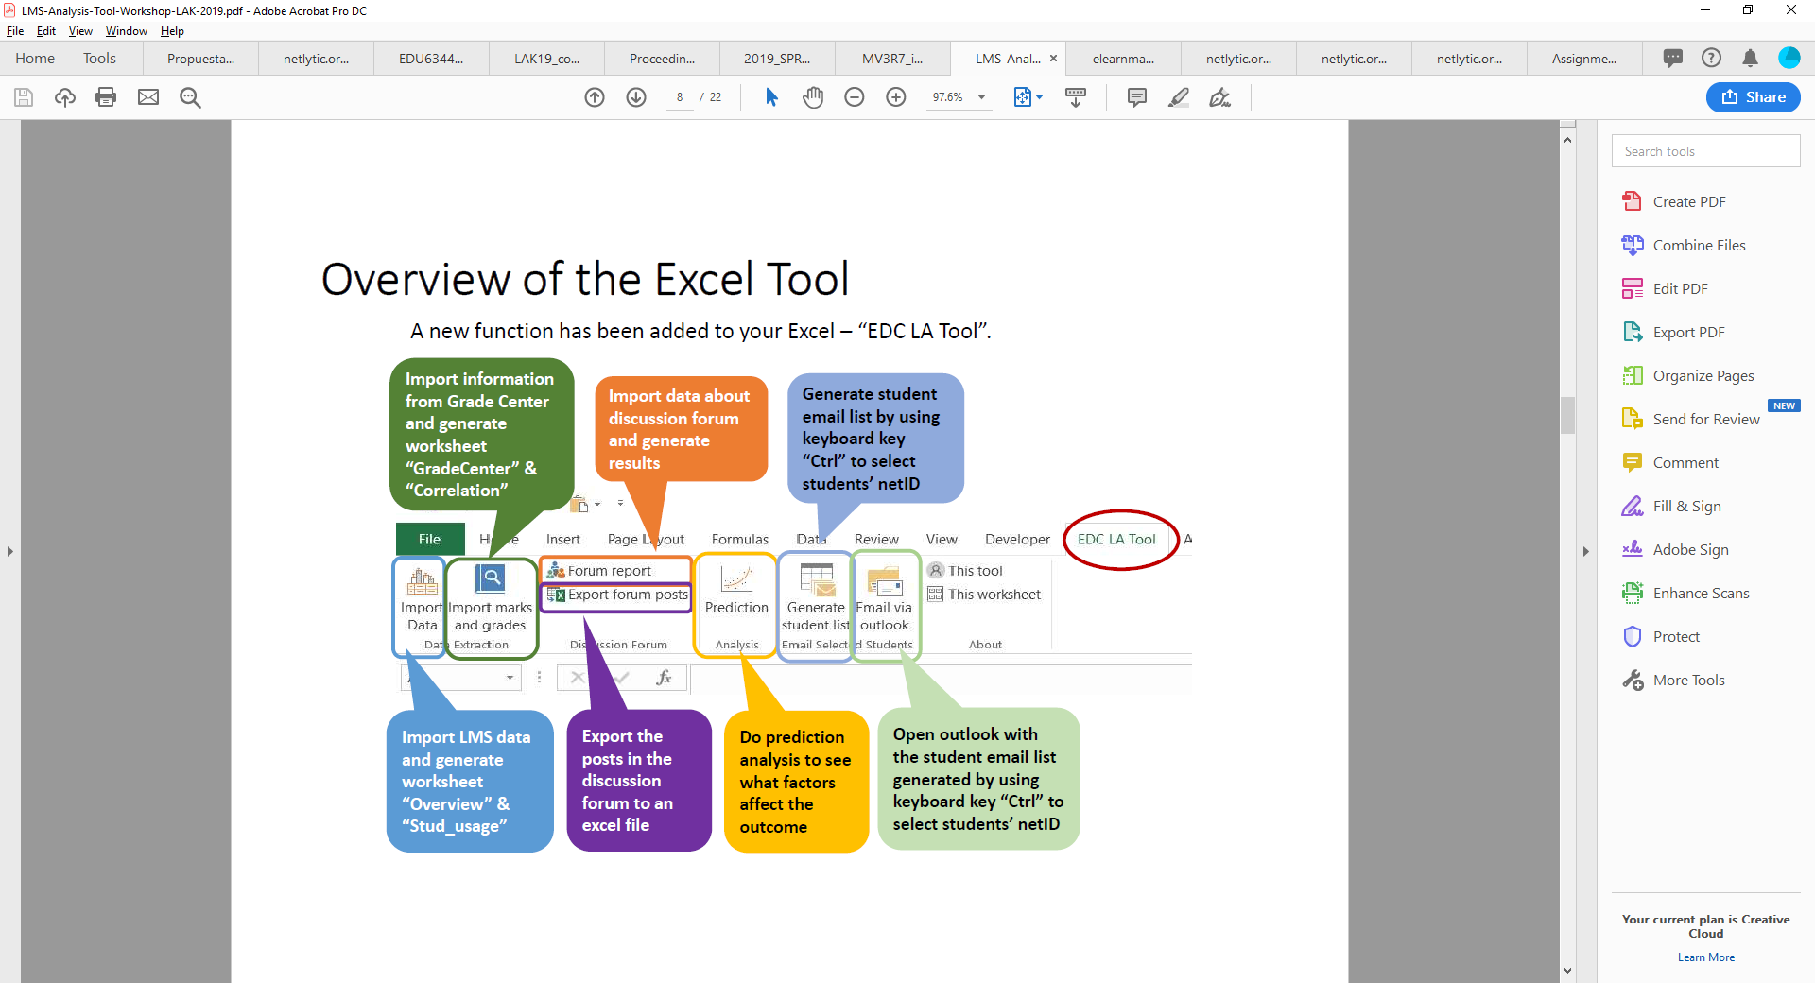
(Armitas, Tse & Chan, 2019)

Slide 8
EDC LA Tool
(Armitas, Tse & Chan, 2019)

Slide 9


Slide 11
Student Views of Instructor Perspective Materials
N=27 students
EDC LA Tool
(Armitas, Tse & Chan, 2019)

Slide 12
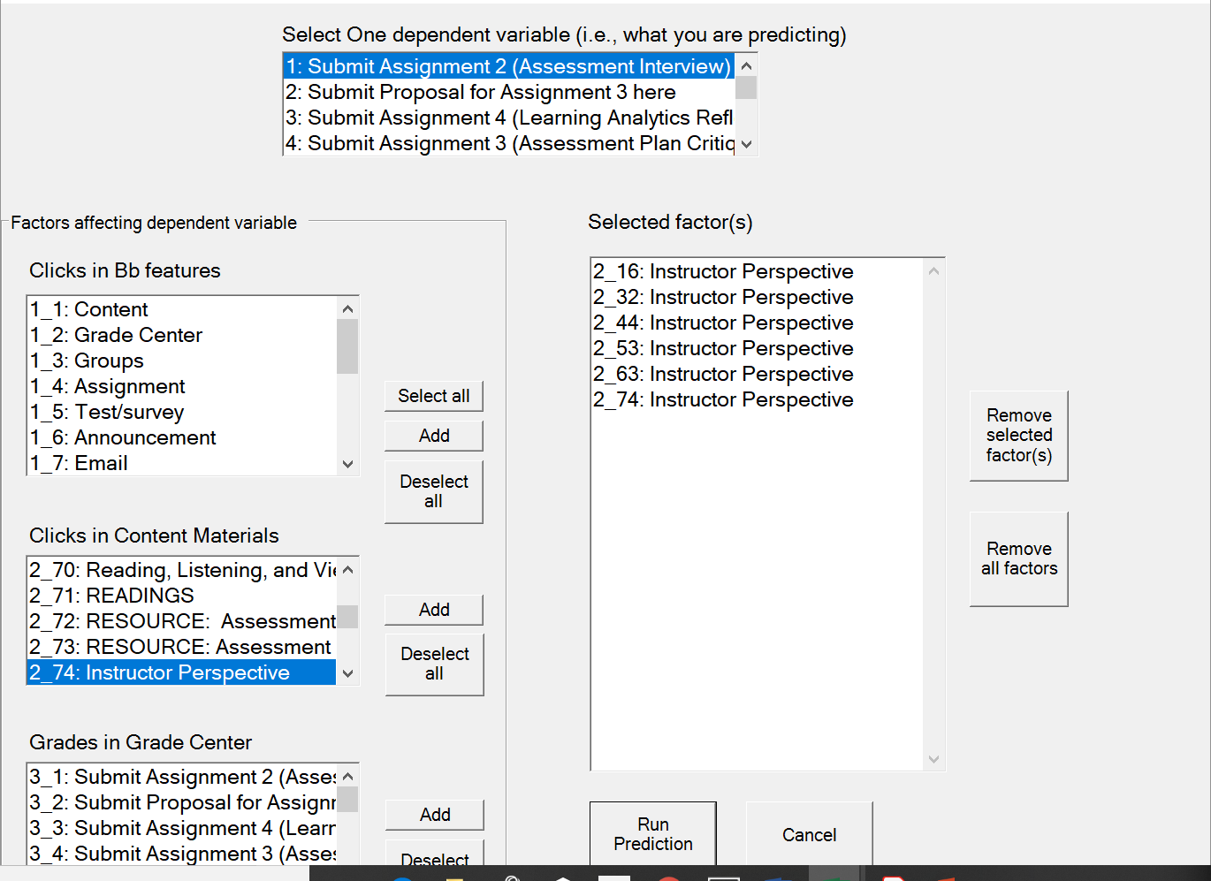
Understanding What Predicts Student Success
A built-in prediction module makes it possible to build and test predictive models based on grades and LMS usage.

Slide 13
Prediction analysis (Model 7)
Dependent Variable (i.e., what you are predicting) = |  | Assignment 2 (Assessment Interview)
Variance in students' performance explained by these factors (R-square) = |  | 15.6%
Number of students included in the analysis = |  | 27
Factors affecting dependent variable |  | Unstandardised Beta (B) | Standardised Beta (beta) | Significant Factors | Importance (Rank)
Clicks in Content Materials | 2_16: Instructor Perspective (Week 1) | 0.22 | 0.29
Clicks in Content Materials | 2_32: Instructor Perspective (Week 2) | 0.05 | 0.04
Clicks in Content Materials | 2_44: Instructor Perspective (Week 3) | 0.18 | 0.12
Clicks in Content Materials | 2_53: Instructor Perspective (Week 4) | 0.27 | 0.21
Clicks in Content Materials | 2_63: Instructor Perspective (Week 5) | -0.37 | -0.30
Clicks in Content Materials | 2_74: Instructor Perspective (Week 6) | 0.10 | 0.14

Slide 14
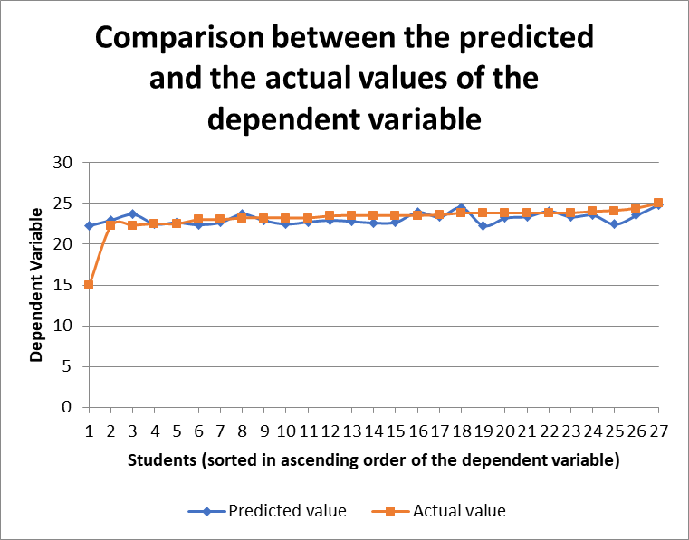

Slide 15
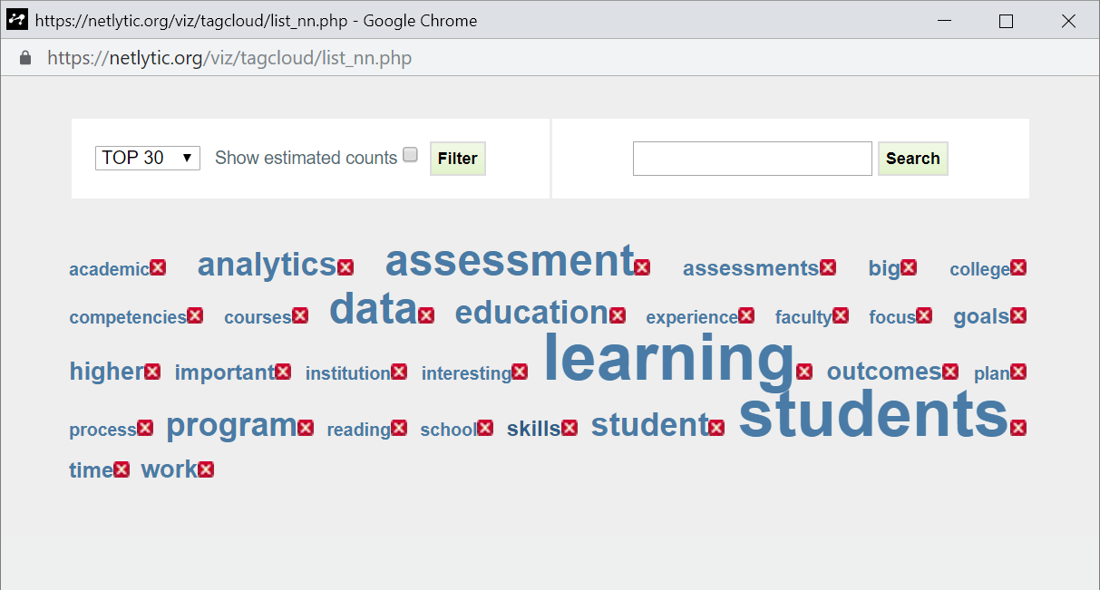
Analysis of Discussion Board Data
Most frequent words
(http://Netlytic.org)

Slide 16
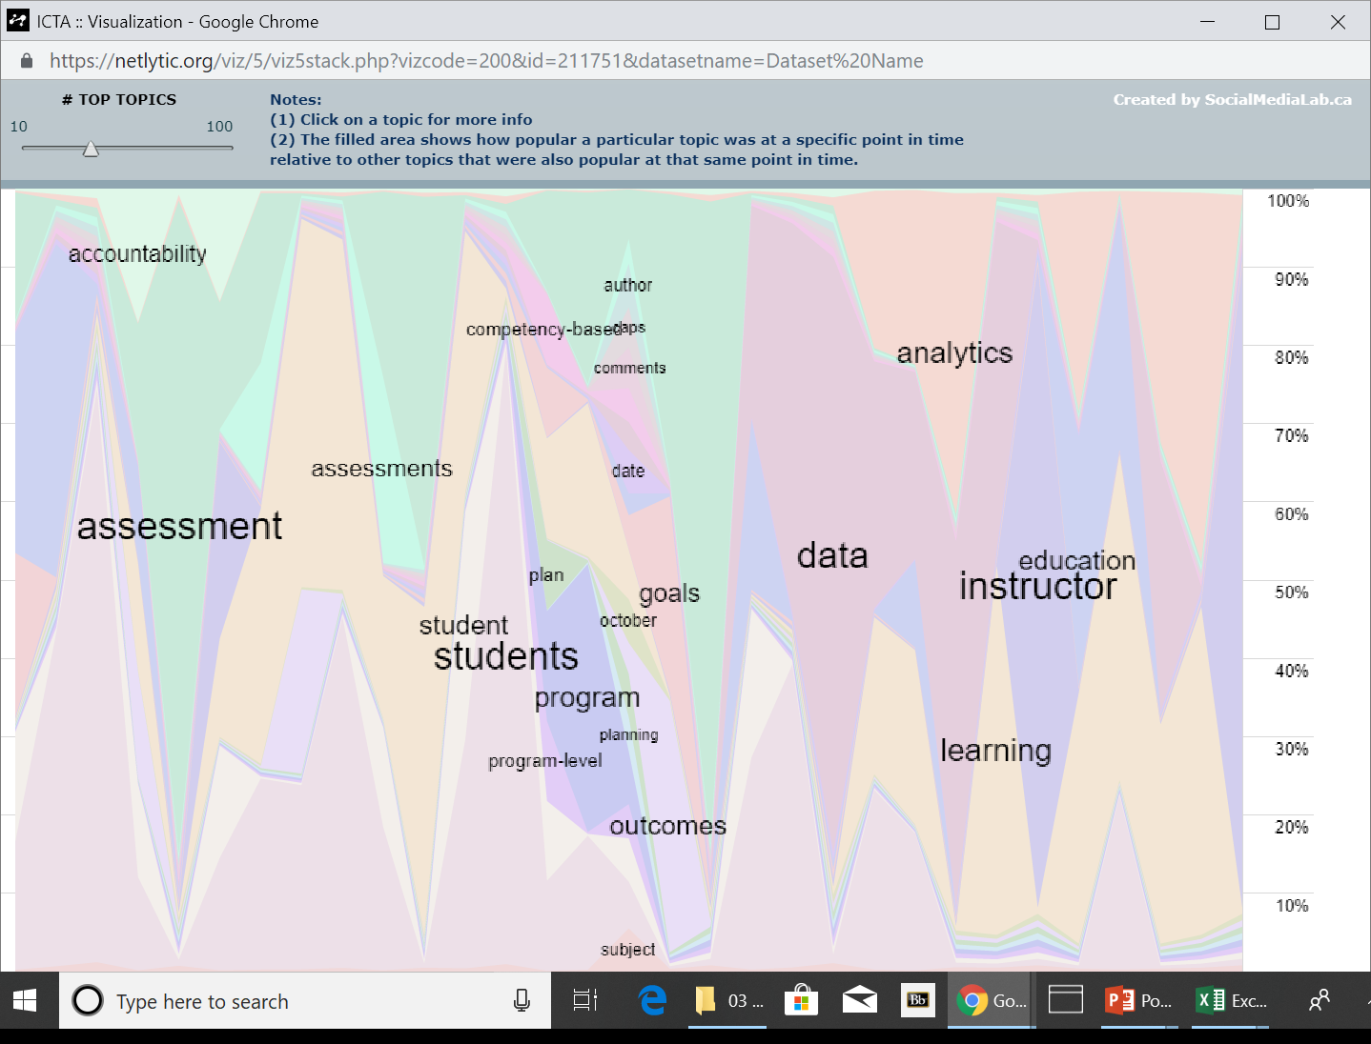
Worlds
over
Time
(http://Netlytic.org)

Slide 17
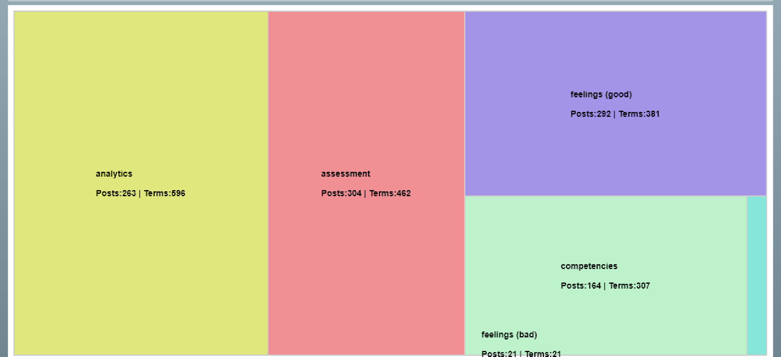
Themes/Categories
(http://Netlytic.org)

Slide 18
Social Network Analysis (SNA) of Discussions
SNA explores social connections in online classes
Makes it possible to:
  Examine how knowledge is being co-constructed
  Judge whether the communication networks formed as part of the class are effectively supporting information sharing, community building, and collaboration
“Name networks” show connections between online participants based on direct interactions such as replies or indirect interactions such as mentions or retweets (Gruzd, Paulin, & Haythornwaite, 2016)
  A useful diagnostic tool for educators to evaluate and improve teaching methods (Gruzd, 2009)

Slide 19
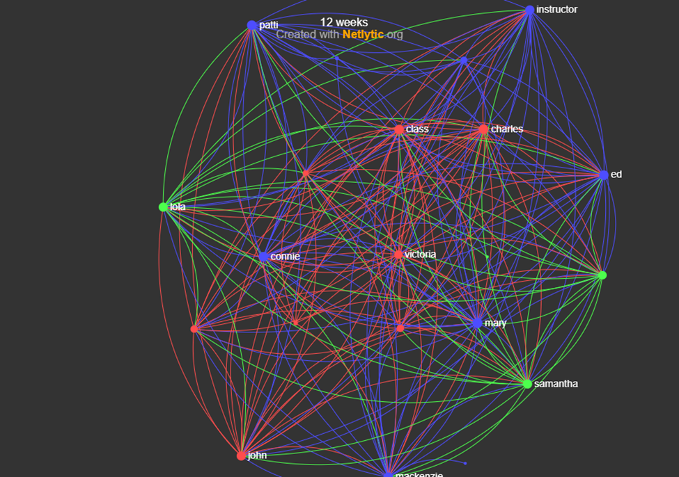
Diameter: 5
  Longest distance between 2 participants
  How far info has to travel between 2 furthest members of a network
  Want this to be low
Density: 0.55
How close participants are in network
Range: 0 (almost no one connected to others) to 1 (participants talk to many others; tight knit community)
Reciprocity: 0.84
% of ties that show two-way communication
Range: 0 (one-sided conversations) to 1 (everyone responds to everyone)
Centralization: 0.27
Range: 0 (information flows freely among members) to 1 (a few central members dominate flow of info in network)
Modularity: 0.06
Degree of fragmentation of discussions
Range: 0 (one coherent group engaged in same conversation and paying attention to each other) to 1 (clear divisions/weak overlap between communities) ; Values < .05 desirable
(http://Netlytic.org)
SNA of 12 weeks of discussions
3 “clusters” or networks
(Pseudonyms are used)

Slide 20
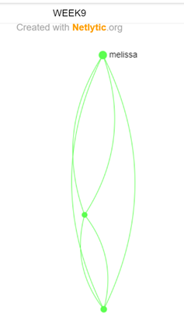
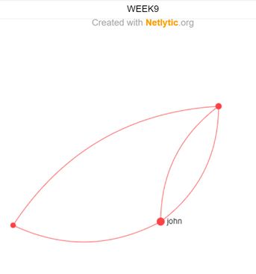
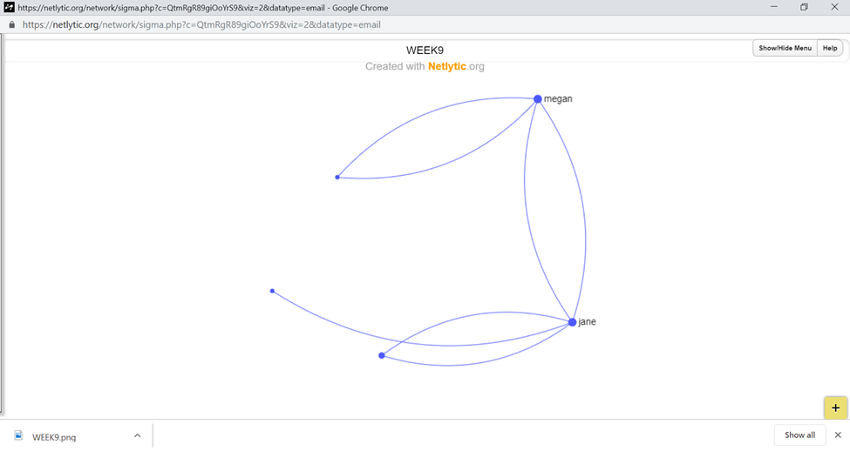
Uses of SNA
Examine change in information flow, cohesiveness, collaboration over time
See who works well with whom
Identify “isolated” students and intervene/check in
Pseudonyms are used
(http://Netlytic.org)

Slide 21
Conclusions
Online courses generate a rich amount and variety of data that can be used to test and revise/improve our learning design and course delivery.
There are some free tools that facilitate this, yielding very interesting and valuable data that allow us to examine and improve our learning designs.
  Enables faculty and course designers to contribute to and augment existing good practices by improving them with insights and technical affordances.
  Avoids the oversimplification of learning enhancement to a data-driven, algorithmic process

Slide 22
References
Armitas, C., Tse, A. & Chan, C.S. (2019). Analyzing learners’ online behavior for student success and course enhancement: Case-studies from Blackboard. Workshop at the 9th International Learning Analytics and Knowledge (LAK) Conference, Tempe, AZ.
Duval, E. (30 January 2012). Learning Analytics and Educational Data Mining, Erik Duval’s Weblog. https://erikduval.wordpress.com/2012/01/30/learning-analytics-and-educational-data-mining/
Gruzd, A. (2016). Netlytic: Software for Automated Text and Social Network Analysis. Available at http://Netlytic.org.
Gruzd, A. (2009). Studying collaborative learning using name networks. Journal of Education for Library & Information Science, 50(4), 237-247.
Gruzd, A., Paulin, D., & Haythornwaite, C. (2016). Analyzing social media and learning through content and social network analysis: A Faceted methodological approach. Journal of Learning Analytics, 3(3), 46-71.
Shibani, A., Knight, S., Buckingham Shum, S. (2019). Contextualizable learning analytics design: A generic model and writing analytics evaluations. Paper presented at the 9th International Learning Analytics and Knowledge (LAK) Conference, Tempe, AZ.
Siemens, G. (2011). Learning and Academic Analytics. http://www.learninganalytics.net/?p=131

